Slide 1
NON-WSQ COURSE • C1382
Version v5.2 · 27 October 2026
Claude AI Masterclass
Classic Projects Edition
Projects, artefacts, connectors, skills and content — for marketing teams
Tertiary Infotech Academy Pte Ltd
UEN: 201200696W
www.tertiarycourses.com.sg | enquiry@tertiaryinfotech.com | +65 6100 0613
© Tertiary Infotech Academy Pte Ltd

Slide 2
1
Introductions
COURSE ADMINISTRATION
2
Ground rules
Welcome
3
Course outline
4
How today runs
© Tertiary Infotech Academy Pte Ltd
Claude AI Masterclass
2

Slide 3
ICE-BREAKER
Let's Know Each Other
Take a minute to introduce yourself to the class.
Your name and role
Which team you sit in and what you are responsible for.
Your marketing work
One piece of content or report you produce again and again.
1
2
Your channels
Which social platforms and tools your team actually uses.
Your goal today
What you would most like Claude to take off your plate.
3
4
© Tertiary Infotech Academy Pte Ltd
Claude AI Masterclass
3

Slide 4
INTRODUCTION
About the Trainer
✓
Qualifications: ____________________________________________
TN
✓
Expertise: _________________________________________________
[ Trainer Name ]
[ Title / Role ]
✓
Experience: ________________________________________________
✓
Contact / Profile: __________________________________________
© Tertiary Infotech Academy Pte Ltd
Claude AI Masterclass
4

Slide 5

INTRODUCTION
About the Trainer
✓
PhD-qualified trainer specialising in AI, software engineering and developer tooling.
AC
✓
Hands-on experience building agentic AI applications and automations with Claude.
Dr. Alfred Ang
AI Trainer & Engineer
✓
Trains professionals across Singapore on practical, project-based AI skills.
✓
Certifications: Claude Certified Associate (Foundations), PMP, AWS, Microsoft, CompTIA, CKA, CKAD.
●
linkedin.com/in/angchewhoe
●
github.com/alfredang
© Tertiary Infotech Academy Pte Ltd
Claude AI Masterclass
5

Slide 6
HOUSEKEEPING
Ground Rules
Phones on silent
Step out quietly if you need to take a call.
Ask as you go
No question is too small — others usually have the same one.
Learn by doing
Every block of theory is followed by a lab you build yourself.
Use the mock data
Never bring real customer or personal data into a training exercise.
Check before you publish
Approve every post and email against the source facts.
Mutual respect
One conversation at a time; agree to disagree.
© Tertiary Infotech Academy Pte Ltd
Claude AI Masterclass
6

Slide 7
ROADMAP
Course Outline
1
2
3
Claude Projects and Market Research
Connectors, Skills and Plugins
Content Production and Scheduled Work
• The Claude family and setup
• Projects: instructions, context, folder, scheduled
• Parallel tasks for parallel work
• Market research and Live Artefacts
• Connectors: Drive and Gmail
• Context window housekeeping
• Slides, Docs and built-in skills
• Agent Skills, plugins and mods
• One prompt, four platforms
• Social post specs and brand checks
• Script, storyboard, render: the video pipeline
• Scheduled tasks and the memory file
© Tertiary Infotech Academy Pte Ltd
Claude AI Masterclass
7

Slide 8
WHAT YOU'LL ACHIEVE
Learning Outcomes
1
Set up the Project
Set up a Claude Project in Cowork with instructions, context, a working folder and a project memory file.
2
Research in parallel tasks
Run multi-subject market research as parallel tasks in one project and consolidate it into one verified research brief.
3
Build a Live Artefact
Build, refine, save and download a Live Artefact dashboard from supplied research data.
4
Connect Drive and Gmail
Connect Google Drive and Gmail so Claude reads campaign files and sends an approved summary.
5
Slides and Docs
Produce a launch deck and a campaign brief with Claude's Slides and Docs, using built-in skills.
6
Skills and plugins
Capture a brand voice as an Agent Skill with /skill-creator, and install and use a marketing plugin.
7
Social posts
Create a two-week, multi-platform set of social media posts using the brand-voice skill.
8
Make a launch video
Produce a short vertical launch video from a script, storyboard and supplied brand assets.
9
Schedule and review
Schedule recurring project tasks and keep the project's instructions, context and memory file current, with a human approval step.
© Tertiary Infotech Academy Pte Ltd
Claude AI Masterclass
8

Slide 9
SCHEDULE
Lesson Plan — One Day
9:00am – 6:00pm, with a one-hour lunch and two tea breaks.
Morning
Afternoon
• 9:00 Welcome
• 9:20 Topic 1 — Claude Projects and Market Research
• 9:55 Hands-on: Lab 1
• 10:20 Tea break
• 10:35 Hands-on: Lab 2
• 11:15 Topic 1 — Live Artefacts
• 11:25 Hands-on: Lab 3
• 12:05 Topic 2 — Connectors, Skills and Plugins
• 12:30 Lunch break
• 13:30 Hands-on: Lab 4
• 14:05 Topic 2 — Slides, Docs and Agent Skills
• 14:15 Hands-on: Lab 5
• 14:45 Hands-on: Lab 6
• 15:15 Tea break
• 15:30 Topic 2 — Plugins and mods
• 15:40 Hands-on: Lab 7
• 16:05 Topic 3 — Content Production and Scheduled Work
• 16:15 Hands-on: Lab 8
• 16:55 Hands-on: Lab 9
• 17:25 Hands-on: Lab 10
• 17:45 Recap
© Tertiary Infotech Academy Pte Ltd
Claude AI Masterclass
9

Slide 10
LEARNING APPROACH
How You'll Learn
1
2
3
4
5
Watch
▶
Build
▶
Check
▶
Discuss
▶
Reuse
The trainer demonstrates the technique live.
You build it yourself in the hands-on lab.
Verify your output against the lab's check step.
We troubleshoot together as a class.
Take the artefact and the prompt back to your own work.
Ten labs, one continuous scenario — each lab builds on the one before it.
© Tertiary Infotech Academy Pte Ltd
Claude AI Masterclass
10

Slide 11
BEFORE WE START
Your Course Materials
Open the prompts page now — you will paste from it in every lab.
Copy-ready prompts
https://tertiarycourses.github.io/C1382-Claude-AI-Masterclass/prompts/ — every lab's prompt with a copy button. Keep it open in a browser tab all day.
1
Lab files and data
https://github.com/tertiarycourses/C1382-Claude-AI-Masterclass — each lab folder holds its prompt PDF and, where needed, a data folder of mock files.
2
Your Learner Guide
The full step-by-step for every lab, the reason for each step, and the check to run at the end.
3
© Tertiary Infotech Academy Pte Ltd
Claude AI Masterclass
11

Slide 12
THE SCENARIO
The Lumo Cold Kopi launch
It is late October 2026. Lumo Kopi Co. launches Lumo Cold Kopi, its first ready-to-drink canned kopi, in Singapore on 1 December — six weeks away — and in Kuala Lumpur in January. The marketing team is small, the budget is S$60,000, and nothing has been produced yet: no research, no deck, no posts, no video.
© Tertiary Infotech Academy Pte Ltd
Claude AI Masterclass
12

Slide 13
THE SCENARIO
One Brand, Ten Labs, One Project
Your role
You are the Lumo marketing team. Instead of juggling a dozen separate chats, you run the whole launch from one Claude Project in Cowork: its instructions, brand kit and working folder are set up once, and every task you start inside it already knows the brand.
Your mission
By the end of the day the project holds everything the launch needs — verified market research, a dashboard, a deck and brief, a brand-voice skill, two weeks of social posts, a launch video — and scheduled tasks that keep it moving while you are away.
Synthetic data only
All brands, figures, survey answers and documents in this course are synthetic and used for training only.
© Tertiary Infotech Academy Pte Ltd
Claude AI Masterclass
13

Slide 14
TOPIC 01
1
The Claude family and setup
Claude Projects and Market Research
2
Projects: instructions, context, folder, scheduled
3
Parallel tasks for parallel work
4
Market research and Live Artefacts
© Tertiary Infotech Academy Pte Ltd
Claude AI Masterclass
14

Slide 15
TOPIC 1 · OVERVIEW
The Claude Product Family
Anthropic offers several Claude products — here's how they differ so you know which is which.
C
Co
D
Claude (Chat + Cowork)
Claude Code
Claude Design
Chat + Cowork in one app — web, desktop & mobile.
The agentic tool for building — terminal, IDE & web.
Polished UI, prototypes & front-end designs.
M
Ch
S
Claude for Microsoft
Claude for Chrome
Claude for Science
Claude inside Excel, PowerPoint, Word & Outlook.
Browser agent that clicks & fills forms in Chrome.
Speeds up research workflows for scientists and labs.
TIP All are powered by the same Claude models — they differ in where they run and who they're for. Projects span Claude and Claude Code.
© Tertiary Infotech Academy Pte Ltd
Claude AI Masterclass
15

Slide 16
TOPIC 1 · OVERVIEW
Claude (Chat + Cowork) and Claude Code
C
Co
Claude (Chat + Cowork)
Claude Code
“Thinking and work partner — this course”
“Build partner”
Best for
Best for
• Chat: ask, draft, analyse and research with web search
• Cowork: plans and runs multi-step tasks on your files
• Projects, connectors and skills: Drive, Gmail, Calendar
• For everyone — web, desktop and mobile apps
• Builds software, sites and automations
• Runs in the terminal, VS Code, desktop app and web
• Edits files, runs commands and calls MCP tools
• Extended with CLAUDE.md, skills, sub agents and hooks
Chat and Cowork are now one app: Claude. A marketing team works there — and a Project ties the work together around one goal.
© Tertiary Infotech Academy Pte Ltd
Claude AI Masterclass
16

Slide 17
TOPIC 1 · OVERVIEW
A Brief History of AI, 2023–2026
Prompt Engineering
Context Engineering
Harness Engineering
AI Agents
2023
2024
2025
2026
ChatGPT goes mainstream; results depend on the prompt wording.
Models call tools and MCP launches; results depend on context.
Claude Code & Codex: systems that plan, act and check their work.
Always-on agents work 24/7 — OpenClaw, Hermes Agent, agent teams.
From wording one prompt → curating context → engineering the harness → AI agents that work around the clock.
© Tertiary Infotech Academy Pte Ltd
Claude AI Masterclass
17

Slide 18
TOPIC 1 · OVERVIEW
What Cowork Mode Adds
Five things a chat window cannot do.
Access local files
Read, write and reorganise the folders on your computer.
Write & run code
It writes the code a task needs — a chart, a video — and runs it for you.
1
2
Connect to tools
Reach Google Drive, Gmail and Calendar through connectors.
Skills & plugins
Reusable instructions it loads on demand, shareable with your team.
3
4
Agent loop
Plan, act, check, correct — it keeps working until the task is done.
5
Together these are why Claude finishes a task instead of describing how to do it.
© Tertiary Infotech Academy Pte Ltd
Claude AI Masterclass
18

Slide 19
TOPIC 1 · SETUP
Claude Plans and Pricing
Free lets you try Claude; Cowork, scheduled tasks and full Projects need Pro or Max.
F
P
M
T
Free
Pro
Max
Team · Enterprise
$0. Chat, Slides, Docs, connectors and skills, up to five projects. Sonnet and Haiku.
$17/mo billed annually · $20 monthly. Cowork, Projects, scheduled tasks and Opus.
From $100/mo — 5× or 20× Pro's usage, priority at busy times, $100–$200/mo API credits.
Team $20/seat annual ($25 monthly), premium seats $100. Enterprise $20/seat + usage.
Parallel tasks multiply usage: four tasks cost roughly four times one chat. Watch Settings → Usage.
TIP Usage resets every five hours, with weekly limits on paid plans. US$ prices as of 27 October 2026 — verify at claude.com/pricing.
© Tertiary Infotech Academy Pte Ltd
Claude AI Masterclass
19

Slide 20
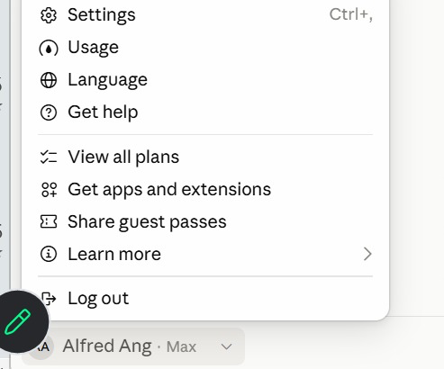
TOPIC 1 · IN THE APP
Check Your Plan and Usage
1
Usage
How much of your five-hour and weekly limits you have used.
2
View all plans
Compare Free, Pro, Max, Team and Enterprise, and upgrade.
3
Settings
Your profile, connectors and capabilities. Shortcut: Ctrl + comma.
Click your name at the bottom of the sidebar — the plan shows beside it (here, Max).
© Tertiary Infotech Academy Pte Ltd
Claude AI Masterclass
20

Slide 21
TOPIC 1 · SETUP
Claude Models: Haiku, Sonnet, Opus and Fable
Four families, smallest to most capable; all read up to 1M tokens. API prices are US$ per million tokens, input · output.
Model
What it is
Use it for
API price
On plans
Haiku 5.5
Fastest, most cost-efficient
Quick, high-volume jobs: tagging, short replies
$0.10 / $0.50
All plans
Sonnet 5.5
High performance for coding and agents
Everyday drafting, research and analysis
$2 / $10
All plans
Opus 5.5
Daily driver for agentic and enterprise work
Multi-step projects, parallel work, careful reviews
$4 / $20
Pro and above
Fable 5.1
Most capable, for long-running agents
The hardest, longest jobs
$10 / $50
Max; Pro via usage credits
Pick the model from the model menu. Bigger models think harder and use more of your plan — save Fable for the jobs that need it.
© Tertiary Infotech Academy Pte Ltd
Claude AI Masterclass
21

Slide 22
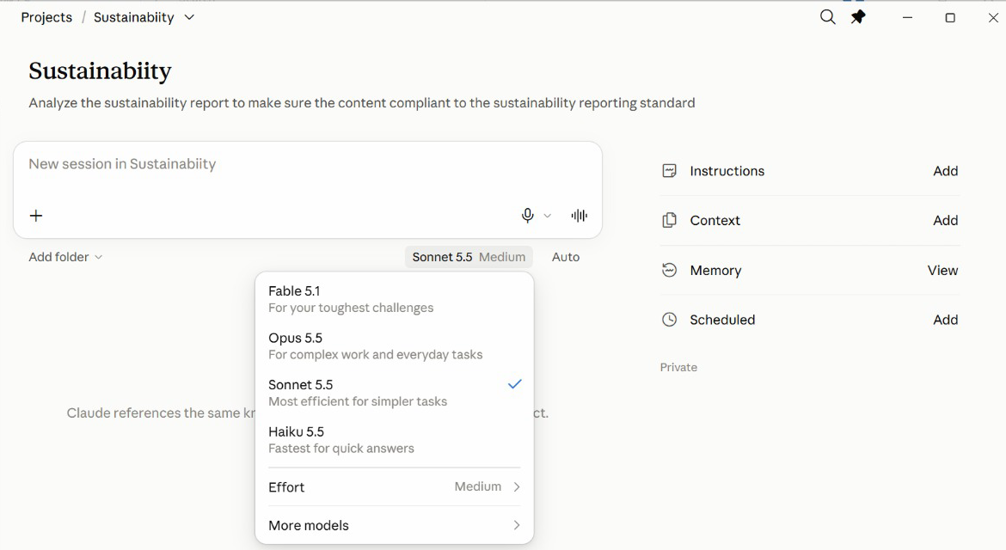
TOPIC 1 · IN THE APP
Pick a Model in the App
1
Fable 5.1
For your toughest challenges — uses the most of your plan.
2
Opus 5.5
Complex work and everyday tasks.
3
Sonnet 5.5
Efficient for most jobs — a sensible default.
4
Haiku 5.5
Fastest, for quick answers.
The model menu sits under the message box of every new session.
© Tertiary Infotech Academy Pte Ltd
Claude AI Masterclass
22

Slide 23
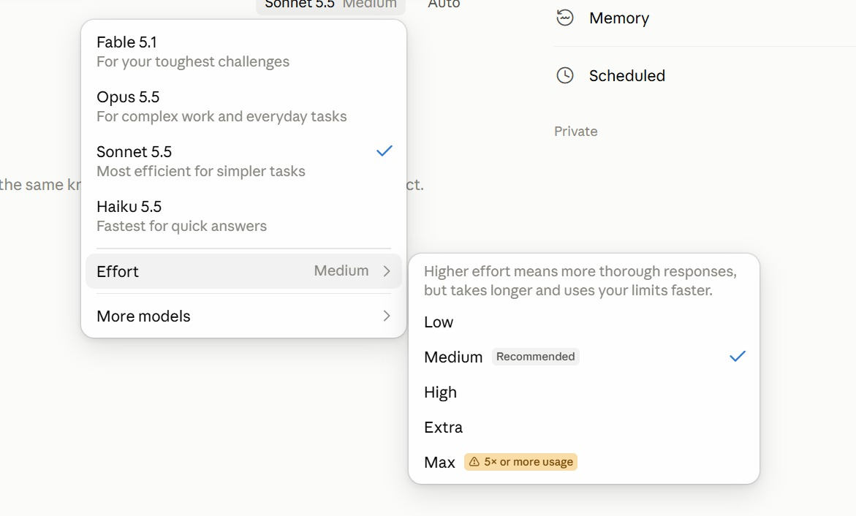
TOPIC 1 · IN THE APP
Effort: How Hard Claude Thinks
1
Low · Medium
Quick, everyday work. Medium is the recommended default.
2
High · Extra
Harder problems: more thorough, but slower and uses your limits faster.
3
Max
Five times or more the usage — save it for the hardest job.
Model menu → Effort. Medium is recommended for most work.
© Tertiary Infotech Academy Pte Ltd
Claude AI Masterclass
23

Slide 24
TOPIC 1 · SETUP
Set Up Claude
Projects, Cowork mode and Live Artefacts run in the Claude desktop app on a paid plan.
Install the desktop app
Download Claude for Mac or Windows from claude.ai/download — Projects, Cowork and Live Artefacts all run there.
Sign in on a paid plan
Use the account that has your Pro or Max subscription.
1
2
Find Projects
Switch to Cowork and open Projects from the sidebar — each project is backed by a folder on your computer.
Download the lab files
Get the course labs from the GitHub repository; each lab has a prompt PDF and a data folder.
3
4
Enable what it needs
Turn on only the connectors a lab needs, from the + menu.
Keep the app open
Tasks and local scheduled tasks stop when the app closes.
5
6
© Tertiary Infotech Academy Pte Ltd
Claude AI Masterclass
24

Slide 25
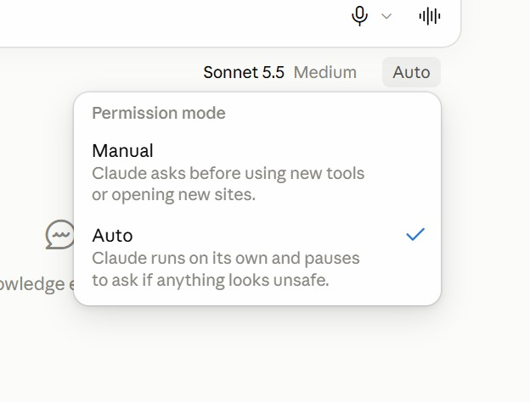
TOPIC 1 · IN THE APP
Permission Mode: Manual or Auto
1
Manual
Claude asks before it uses a new tool or opens a new site.
2
Auto
Claude runs on its own and pauses to ask only if something looks unsafe.
3
Which to use
Manual while you learn a new connector; Auto once you trust the job.
The menu beside the model sets how freely Claude acts in a session.
© Tertiary Infotech Academy Pte Ltd
Claude AI Masterclass
25

Slide 26
TOPIC 1 · PROJECTS
Claude Projects in Cowork
Set up the brand and the rules once; every task starts from them.
One-off chats
A Claude Project in Cowork
• A chat for copy, one for visuals, one for competitors.
• Re-attach the brand kit every time.
• Restate the rules from memory each time.
• Outputs scattered across conversations.
• Nothing for a colleague to pick up.
• Instructions written once, followed by every task.
• The brand kit added once as context.
• A real working folder Claude reads and writes.
• Scheduled tasks that belong to the project.
• Hand the folder to a colleague and they are ready.
© Tertiary Infotech Academy Pte Ltd
Claude AI Masterclass
26

Slide 27
TOPIC 1 · PROJECTS
Project vs Session
The project is the room; a session is one working day in it.
A session — one piece of work
A project — the whole goal
• One conversation with Claude: a chat, or a task in Cowork.
• Has its own context window, which fills up as you work.
• Ends when the job is done; the next session starts blank.
• Remembers only what was said inside it.
• Lumo: “Draft the Instagram launch post.”
• A lasting workspace that holds many sessions.
• Its instructions, context and folder load into every session.
• Stays until you delete it — for weeks or months.
• What one session decides, the next reads from the memory file.
• Lumo: “Lumo Cold Kopi Launch.”
© Tertiary Infotech Academy Pte Ltd
Claude AI Masterclass
27

Slide 28
TOPIC 1 · PROJECTS
How Sessions Sit Inside a Project
Claude Project
You
Project set-up
Key
Start each session
inside the project
◀ ▶
Instructions · Context
Folder · Scheduled
Project = the lasting workspace
Session = one conversation
Each session starts fresh
Session 1
Session 2
Session 3
Scheduled
Market research
Monday
Instagram post
Tuesday
Launch video
Wednesday
Post drafts
every Monday 9am
Memory file in the folder: what one session decides, the next one reads
Close a session and its chat ends, but the project's instructions, context, folder and memory file are still there for the next one.
© Tertiary Infotech Academy Pte Ltd
Claude AI Masterclass
28

Slide 29
TOPIC 1 · PROJECTS
Inside a Project
Claude Project
A folder-backed project with four panels
Instructions
Context
Folder
Rules every
task follows
Files Claude
reads
Where Claude
works
Scheduled
Your tasks
Memory file
Tasks on a
timetable
Run one or
several at once
Decisions kept
in the folder
Every task you start in the project reads its instructions, context and folder. Start several at once and they run in parallel — one task per subject.
© Tertiary Infotech Academy Pte Ltd
Claude AI Masterclass
29

Slide 30
TOPIC 1 · PROJECTS
A Project Answers Four Questions
The four panels on the project page, each answering one question.
Instructions → HOW
How Claude must work: brand voice, prices in S$, ask before sending — rules every task follows.
Context → WHAT
What Claude needs to know: brand guidelines, product sheet, launch brief — read, never edited.
1
2
Folder → WHERE
Where Claude works: the real folder on your computer it reads data from and saves outputs to.
Scheduled → WHEN
When work runs without you: Monday 9am the week's post drafts, Friday the weekly report.
3
4
The memory file in the folder keeps what each session decides for the next.
© Tertiary Infotech Academy Pte Ltd
Claude AI Masterclass
30

Slide 31
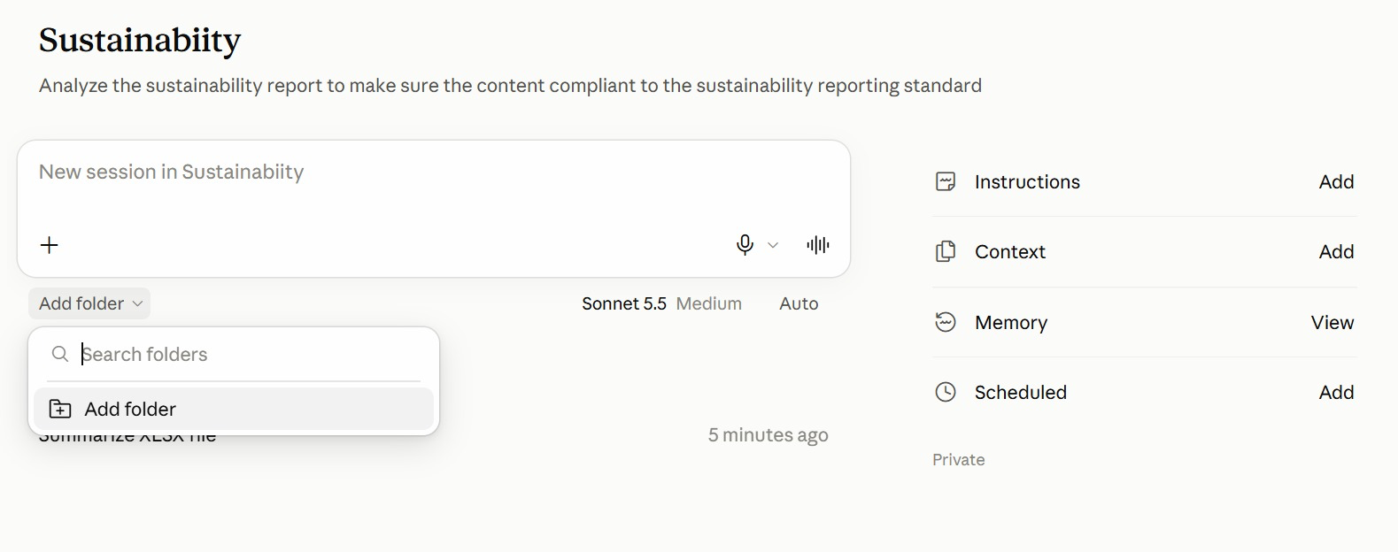
TOPIC 1 · IN THE APP
The Project Page in the App
1
Instructions · Context
HOW and WHAT — click Add to write the rules or attach reference files.
2
Add folder
WHERE — under the message box, pick the folder Claude reads from and saves to.
3
Memory · Scheduled
What Claude has learned about the project, and WHEN tasks run on their own.
4
New session
Type in the box to start a session; earlier sessions are listed beneath it.
A project from the class: the goal under its name, the project's panels on the right.
© Tertiary Infotech Academy Pte Ltd
Claude AI Masterclass
31

Slide 32
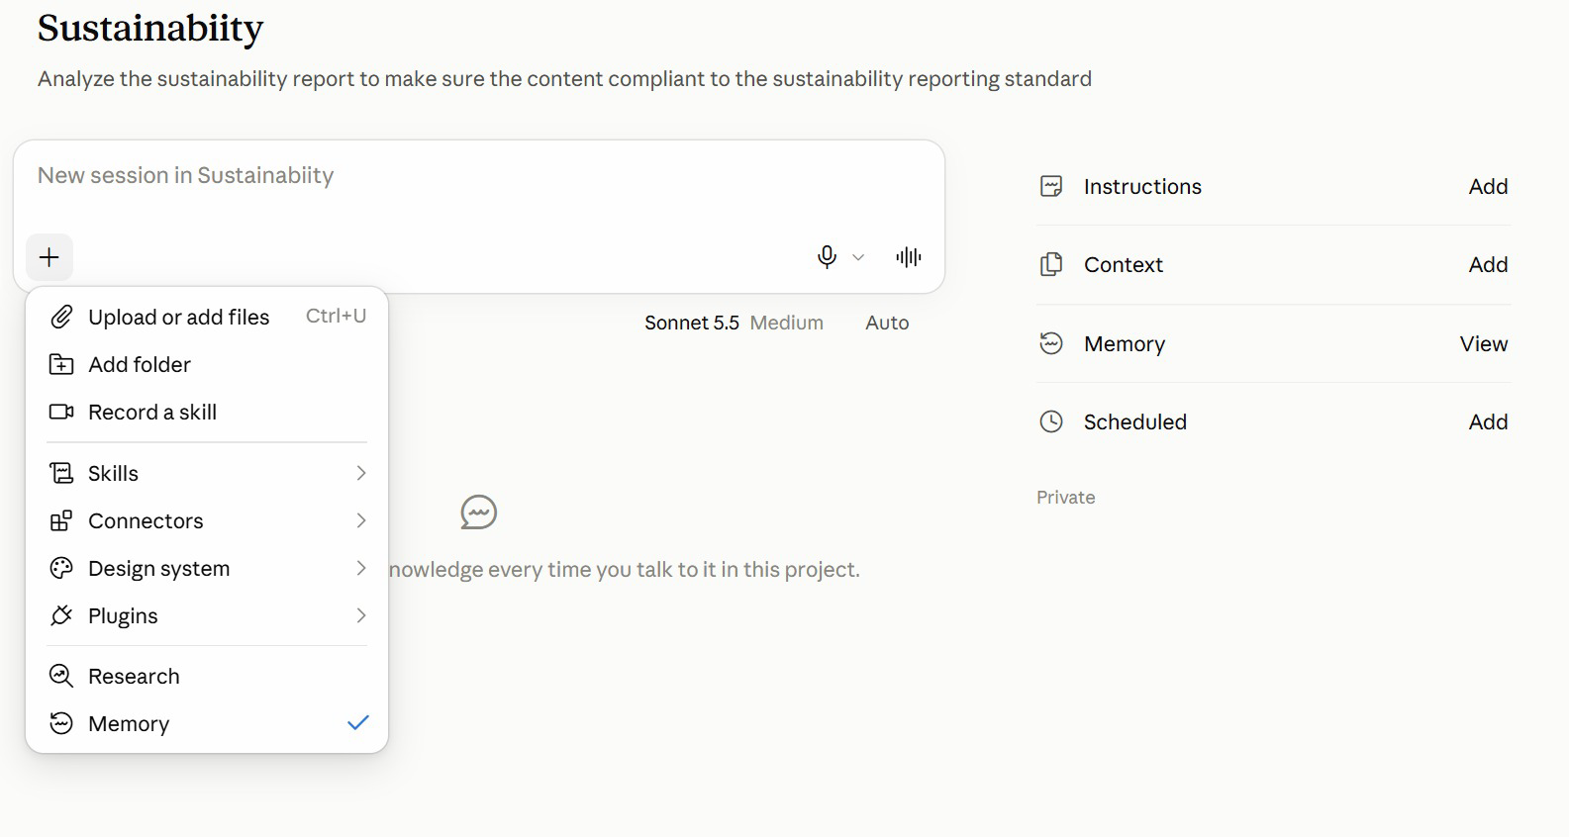
TOPIC 1 · IN THE APP
The + Menu: What a Session Can Use
1
Files and folders
Upload a file, or add a folder, for this session.
2
Skills · Connectors · Plugins
Choose what the session may use — the brand-voice skill, Gmail, a plugin.
3
Record a skill
Capture a routine you show Claude as a new skill.
4
Research · Memory
Deeper web research; the tick shows the session uses project memory.
Click + in the message box to bring files and tools into the session.
© Tertiary Infotech Academy Pte Ltd
Claude AI Masterclass
32

Slide 33
TOPIC 1 · PROJECTS
When to Use a Project
A long-running goal
Work keeps arriving for weeks — a product launch, a channel, an app.
A job that splits
One big job breaks into pieces that can run at once — assets, ads, competitors, email.
1
2
Lots of research
Many subjects to look into — one task per competitor, market or segment.
Regular routines
Work that repeats on a timetable — scheduled tasks that belong to the project.
3
4
A one-off question that is done in one reply? Use an ordinary chat.
© Tertiary Infotech Academy Pte Ltd
Claude AI Masterclass
33

Slide 34
TOPIC 1 · PROJECTS
Anatomy of a Project
The four panels on the project page, the tasks you run, and the memory file you keep.
Instructions
Standing rules you write: brand voice, currency, never publish without approval.
Context
Documents Claude READS and never edits — the brand guidelines, product sheet and launch brief.
1
2
Folder
A real folder on your computer where Claude WORKS: it reads the data there and writes output back.
Scheduled
Recurring tasks that belong to this project — the daily post draft, the weekly report.
3
4
Tasks
Each job you start in the project. Several can run at once, one per subject.
Memory file
lumo-project-memory.md in the folder: decisions you ask Claude to record, read by every later task.
5
6
© Tertiary Infotech Academy Pte Ltd
Claude AI Masterclass
34

Slide 35
TOPIC 1 · PROJECTS
Creating a Project, Field by Field
New project opens the Create a project dialog.
What are you working on?
The project's name — Lumo Cold Kopi Launch. This is how you find it in the sidebar.
1
What are you trying to achieve?
The goal in two or three sentences. Every task in the project inherits it.
2
Use a folder
Point the project at a folder on your computer, so the files and outputs are yours to open.
3
Create project
The project page opens with four panels: Instructions, Context, Folder and Scheduled.
4
Start a new project from Projects in Cowork. The instructions and context are added afterwards, from the project page.
© Tertiary Infotech Academy Pte Ltd
Claude AI Masterclass
35

Slide 36
TOPIC 1 · PROJECTS
Instructions vs Context
Quick test: a sentence that starts Always, Never or Write in… is an instruction. A document is context.
Instructions — how to behave
Context — what to know
• Short standing rules you write in the Instructions panel.
• Followed by every session in the project.
• Like the house rules pinned on the office wall.
• Keep them short: they are loaded into every session.
• Lumo: “Prices in S$. No health claims. Ask before sending.”
• Reference documents Claude reads but never edits.
• Files you add in the Context panel.
• Like the reference binders on the office shelf.
• Add them once; you never re-attach them again.
• Lumo: brand guidelines, product sheet, launch brief.
© Tertiary Infotech Academy Pte Ltd
Claude AI Masterclass
36

Slide 37
TOPIC 1 · PROJECTS
Instructions, Context or Memory?
When the output is wrong, this tells you which one to edit.
Instructions
Context
Memory file
Who writes it
You
You add it
Claude, when you ask it to
What it holds
Rules and style
Files to read
Decisions and facts to keep
Lumo example
Prices in S$; no health claims
Brand guidelines, launch brief
Launch date moved to 8 December
Edit it in
The Instructions panel
The Context panel
lumo-project-memory.md in the folder
When output is wrong
Tighten the rule
Add the missing file
Correct the line in the file
© Tertiary Infotech Academy Pte Ltd
Claude AI Masterclass
37

Slide 38
TOPIC 1 · PROJECTS
An Analogy: The Project Room
Picture the project as a room your team works in for the whole launch.
In Claude
In the office
What it means
Lumo example
Project
The project room
Stays set up for weeks
Lumo Cold Kopi Launch
Session
One working day in the room
Starts fresh; the room is still set up
Draft the Instagram post
Instructions
House rules on the wall
How every session must behave
Prices in S$; no health claims
Context
Binders on the shelf
What Claude reads, never edits
Brand guidelines, product sheet
Folder
The desk
Where work is done and left
Survey CSV in, posts out
Scheduled
The room's recurring calendar
Work that runs on a timetable
Monday 9am: the week's posts
Memory file
The team logbook
Decisions kept between sessions
Launch price confirmed at S$3.90
© Tertiary Infotech Academy Pte Ltd
Claude AI Masterclass
38

Slide 39
TOPIC 1 · PROJECTS
Why a Project?
A dedicated place for ongoing work, where context builds over time.
Working in one-off chats
Working in a Claude Project
• You re-attach the brand kit every session.
• Rules are restated from memory each time.
• Research, posts and artefacts are scattered.
• A colleague has to be told how you set it up.
• Work stops when you stop typing.
• Context is added once and read by every task.
• Instructions apply to every task in the project.
• Outputs land together in the project folder.
• A colleague opens the folder and is ready.
• Scheduled tasks run while you are away.
© Tertiary Infotech Academy Pte Ltd
Claude AI Masterclass
39

Slide 40
TOPIC 1 · COMING SOON
Coming Soon: Projects with a Lead Agent and Threads
Anthropic redesigned Claude Projects in September 2026. The new version is in beta, rolling out to Pro and Max accounts first — if your Projects page shows a Goal and talks about threads, you already have it.
Lead agent
You state a goal once; a coordinator plans the work, splits it and merges the results.
Parallel threads
The lead agent starts one thread per subject itself — what you do by hand with tasks in Lab 2.
1
2
Goal
One outcome statement that every decision in the project steers toward.
Project memory
Memory the project writes and you edit in settings — replacing the memory file you keep in Lab 1.
3
4
Usage per thread
Project settings show the tokens used by the lead agent and by each thread.
Cloud environment
Threads keep working in the cloud with your laptop closed.
5
6
© Tertiary Infotech Academy Pte Ltd
Claude AI Masterclass
40

Slide 41
TOPIC 1 · COMING SOON
Today's Labs on the New Projects
In today's labs (classic)
With the new Projects
Lab 2: you start four tasks, then a merge task
One message; the lead agent starts four threads and merges them
Lab 8: one task drafts all four platforms
One thread per platform, merged into one calendar
lumo-project-memory.md in the folder
Project settings → Memory, editable memory files
Instructions panel
Project instructions under settings, plus a Goal
Settings → Usage for your whole plan
Usage per thread for this project
Everything you build today carries over: skills, connectors, artefacts and scheduled tasks work the same way. The Threads edition of this course runs the same ten labs on the new Projects — see the course repository.
© Tertiary Infotech Academy Pte Ltd
Claude AI Masterclass
41

Slide 42
TOPIC 01 · KEY CONCEPTS
Key Concepts — Claude Projects and Market Research
Claude Project
A home for a long-running body of work. Its rules, files and outputs build up instead of resetting each chat.
Backed by a folder
In Cowork a project points at a real folder on your computer — Claude works there, and you can open it yourself.
1
2
Instructions
Standing rules every task in the project follows: currency, brand voice, approval before sending.
Context vs Folder
Context is what Claude reads and never edits. Folder is where it works — reading data and writing output.
3
4
Parallel tasks
Several tasks can run in one project at once — one per subject — and a final task merges their files.
Live Artefacts
Interactive tools — dashboards, trackers — that persist in your workspace instead of scrolling away in chat.
5
6
© Tertiary Infotech Academy Pte Ltd
Claude AI Masterclass
42

Slide 43
LAB 01 · HANDS-ON
Set Up the Lumo Launch Project
LAB 01
Objective: Create a Claude Project in Cowork with instructions, context, a working folder and a memory file
Lumo Kopi Co. launches Lumo Cold Kopi in six weeks, and the marketing work will keep coming until launch day — exactly what a Claude Project is for. You create the Lumo Cold Kopi Launch project in Cowork, point it at a working folder, write its standing instructions, add the brand kit as context, and check that Claude understood all of it. Every later lab runs inside this project.
YOU'LL BUILD
The Lumo Cold Kopi Launch project, with instructions, three context files, a working folder and a project memory file.
Tools: Claude desktop app (Cowork), Claude Projects
© Tertiary Infotech Academy Pte Ltd
Claude AI Masterclass
43

Slide 44
LAB 01 · IN THE PROJECT
Lab 01 in the Project
What this lab sets up, uses, adds or schedules in the project.
Instructions → HOW
Set up: paste Block 2 into the Instructions panel — S$ prices, brand guidelines, no health claims, approval first.
Context → WHAT
Set up: add the brand kit in the Context panel — guidelines, product sheet and launch brief.
1
2
Folder → WHERE
Set up: point the project at your Lumo Launch folder; lumo-project-memory.md starts here.
Scheduled → WHEN
Not yet — Lab 8 adds the first scheduled task.
3
4
© Tertiary Infotech Academy Pte Ltd
Claude AI Masterclass
44

Slide 45
LAB 01 · THE PROMPT · STEP 3
Block 1 — GOAL
PROMPT — copy into Claude
Launch Lumo Cold Kopi in Singapore on 1 December 2026.
Produce the market research, a launch deck, a campaign brief,
two weeks of social media posts and a 15-second launch video,
within a S$60,000 budget, so that 25-34 year-olds on Instagram
and TikTok know the product exists by launch day.
NOTE Name: Lumo Cold Kopi Launch. Use a folder: your empty Lumo Launch folder.
© Tertiary Infotech Academy Pte Ltd
Claude AI Masterclass
45

Slide 46
LAB 01 · THE PROMPT · STEP 5
Block 2 — INSTRUCTIONS
PROMPT — copy into Claude
You are the marketing team for Lumo Kopi Co.
- Prices are in Singapore dollars: S$3.90 per can, S$42.00 per
12-pack. Always two decimals.
- Follow lumo-brand-guidelines.md for anything customer-facing.
- Never describe the product as healthy. You may say 5 g sugar.
- Never send an email or publish a post without my approval.
- Save every output to the project folder.
- Read lumo-project-memory.md before you start any task.
- Flag any figure that two sources disagree on. Do not pick one.
NOTE Save the instructions, then add the brand kit under Context.
© Tertiary Infotech Academy Pte Ltd
Claude AI Masterclass
46

Slide 47
LAB 01 · THE PROMPT · STEP 7
Block 3 — FIRST TASK
PROMPT — copy into Claude
Before we start work, check your setup:
1. Restate the project goal in one line.
2. List the context files you can read and what each is for.
3. List the three instructions you think matter most.
4. From the product sheet, give me the price per can, the sugar
per can and the launch date.
Then create lumo-project-memory.md in the project folder with
the heading "Project memory" and record: our primary audience
is 25-34 year-olds in Singapore, and our secondary market is
Kuala Lumpur, launching 15 January 2027.
NOTE Check the four answers, then open the new memory file in the folder.
© Tertiary Infotech Academy Pte Ltd
Claude AI Masterclass
47

Slide 48
LAB 01 · STEPS
Set Up the Lumo Launch Project
Full step-by-step, with the reasoning for each step, is in your Learner Guide.
Download the course labs and open the Lab 01 data/brand-kit folder. Create an empty folder called Lumo Launch on your computer.
Open the Context panel and add the three brand-kit files.
1
6
In the Claude desktop app, switch to Cowork, open Projects and start a new project.
Start a new task in the project and send Block 3.
2
7
Under "What are you working on?" type Lumo Cold Kopi Launch, and paste Block 1 into "What are you trying to achieve?".
Check the answers: S$3.90 per can, 5 g sugar, launch 1 December 2026.
3
8
Choose Use a folder, pick your Lumo Launch folder, and click Create project.
Open the Lumo Launch folder on your computer and read lumo-project-memory.md.
4
9
Open the Instructions panel and paste Block 2. Save.
5
© Tertiary Infotech Academy Pte Ltd
Claude AI Masterclass
48

Slide 49
LAB 01 · VERIFY
Set Up the Lumo Launch Project
✓ Check your work
The Lumo Cold Kopi Launch project exists in Cowork, using your Lumo Launch folder, with the Block 2 instructions saved and the three brand-kit files under Context. Claude restated the goal, listed all three context files, and quoted S$3.90 per can, 5 g sugar and a 1 December 2026 launch. lumo-project-memory.md in the folder records the 25-34 audience and the 15 January 2027 Kuala Lumpur launch.
© Tertiary Infotech Academy Pte Ltd
Claude AI Masterclass
49

Slide 50
TOPIC 1 · RESEARCH IN PARALLEL TASKS
Market Research in Four Tasks
Four subjects, none depending on another — so they can run at once.
Task 1 — Competitors
Six cold-brew brands: price, pack, positioning, and the gap Lumo can own.
Task 2 — Customers
400 survey respondents: who is likely to buy, why, and where they discover drinks.
1
2
Task 3 — Pricing
Where S$3.90 sits against the market, and what the survey says people will pay.
Task 4 — Social trends
Which content themes earn the most engagement in the category right now.
3
4
Start four tasks in the project at once, one subject each, each saving its own file to the folder. A fifth task merges them into the research brief.
© Tertiary Infotech Academy Pte Ltd
Claude AI Masterclass
50

Slide 51
LAB 02 · HANDS-ON
Run Market Research in Parallel Tasks
LAB 02
Objective: Split a multi-subject research job into parallel tasks and verify the merged brief
Before anyone writes a post, the team needs to know the market. Four subjects need research — competitors, the customer survey, pricing and social trends — and none depends on another. So you start four tasks in the project at once, one per subject, each saving its findings to the folder. A fifth task merges the four files into one research brief, which you check against the data.
YOU'LL BUILD
Four research files and lumo-research-brief.docx merged from them, in the project folder.
Tools: Claude Projects in Cowork, parallel tasks, web search
© Tertiary Infotech Academy Pte Ltd
Claude AI Masterclass
51

Slide 52
LAB 02 · IN THE PROJECT
Lab 02 in the Project
What this lab sets up, uses, adds or schedules in the project.
Instructions → HOW
Uses: save every output to the folder, and flag any figure two sources disagree on.
Context → WHAT
Uses: the launch brief, so every task knows the product, price and audience.
1
2
Folder → WHERE
Adds: copy in the three CSVs; four research files and lumo-research-brief.docx are saved here.
Scheduled → WHEN
Not used — you start the four tasks yourself, now.
3
4
© Tertiary Infotech Academy Pte Ltd
Claude AI Masterclass
52

Slide 53
LAB 02 · THE PROMPT · STEP 3
Block 1 — COMPETITORS
PROMPT — copy into Claude
Research COMPETITORS for the Lumo Cold Kopi launch using
lumo-competitors.csv: price per can, pack, positioning and
channel for each brand, and the gap Lumo can own.
Save your findings as research-1-competitors.md in the project
folder.
NOTE Start the next task straight away — these four run in parallel.
© Tertiary Infotech Academy Pte Ltd
Claude AI Masterclass
53

Slide 54
LAB 02 · THE PROMPT · STEP 4
Block 2 — CUSTOMERS
PROMPT — copy into Claude
Research CUSTOMERS using lumo-consumer-survey-2026.csv: the share
likely to buy (intent 4 or 5), split by age band and city; the
top purchase drivers; the top discovery channels. Show your
working for every percentage. Save your findings as
research-2-customers.md in the project folder.
NOTE Show your working is what lets you check every percentage.
© Tertiary Infotech Academy Pte Ltd
Claude AI Masterclass
54

Slide 55
LAB 02 · THE PROMPT · STEP 5
Block 3 — PRICING
PROMPT — copy into Claude
Research PRICING using lumo-competitors.csv and
lumo-consumer-survey-2026.csv: where S$3.90 sits against the
competitor median, and the share of respondents willing to pay
S$3.50 or more. Show your working. Save your findings as
research-3-pricing.md in the project folder.
NOTE "S$3.50 or more" includes S$3.50 exactly.
© Tertiary Infotech Academy Pte Ltd
Claude AI Masterclass
55

Slide 56
LAB 02 · THE PROMPT · STEP 6
Block 4 — TRENDS
PROMPT — copy into Claude
Research SOCIAL TRENDS using lumo-social-trends.csv: the three
content themes with the highest engagement, with one post idea
each. Save your findings as research-4-trends.md in the project
folder.
NOTE Four tasks, four subjects, four fresh context windows.
© Tertiary Infotech Academy Pte Ltd
Claude AI Masterclass
56

Slide 57
LAB 02 · THE PROMPT · STEP 7
Block 5 — MERGE
PROMPT — copy into Claude
Merge research-1-competitors.md, research-2-customers.md,
research-3-pricing.md and research-4-trends.md from the project
folder into one research brief, lumo-research-brief.docx:
a one-paragraph summary, one section per subject with the key
numbers, and three recommendations for the launch. Name the
source file under each section, and flag anything the four
files disagree on.
NOTE You are doing by hand what the new Projects' lead agent does automatically.
© Tertiary Infotech Academy Pte Ltd
Claude AI Masterclass
57

Slide 58
LAB 02 · STEPS
Run Market Research in Parallel Tasks
Full step-by-step, with the reasoning for each step, is in your Learner Guide.
Open the Lab 02 data folder and glance at the three CSV files.
Start a fourth task and send Block 4.
1
6
Copy the three CSV files into your Lumo Launch project folder.
When the four research files are in the folder, start a fifth task and send Block 5.
2
7
Start a new task in the project and send Block 1. Do not wait for it.
When the merged brief arrives, check the survey numbers.
3
8
Start a second task and send Block 2.
Check the channel, driver and pricing findings.
4
9
Start a third task and send Block 3.
Check the trends section and the recommendations.
5
10
© Tertiary Infotech Academy Pte Ltd
Claude AI Masterclass
58

Slide 59
LAB 02 · VERIFY
Run Market Research in Parallel Tasks
✓ Check your work
The project folder holds the four research files and lumo-research-brief.docx, whose summary, four sections and three recommendations name their source files. The brief reports 400 respondents, 248 likely to buy (62%), 112 of 152 aged 25-34 (74%), Instagram as the top discovery channel at 34%, Taste as the top driver at 31%, a competitor median of S$4.30 with Lumo's S$3.90 below it, 228 respondents (57%) willing to pay S$3.50 or more, and Taste tests and first-sip reactions as the top content theme.
© Tertiary Infotech Academy Pte Ltd
Claude AI Masterclass
59

Slide 60
TOPIC 1 · LIVE ARTEFACTS
Why a Live Artefact?
The difference between an answer you read and a tool you keep.
A normal chat answer
A Live Artefact
• A static snapshot in the conversation.
• Scrolls away as the chat grows.
• Figures are frozen at the moment they were written.
• You copy and paste to reuse anything.
• Nothing to click, filter or explore.
• An interactive tool with its own place in the workspace.
• Reopenable — it stays available after the chat ends.
• Can refresh from connected data when reopened.
• Keeps what you typed into it between sessions.
• Clickable: filter, sort and drill into the numbers.
© Tertiary Infotech Academy Pte Ltd
Claude AI Masterclass
60

Slide 61
TOPIC 1 · LIVE ARTEFACTS
Building a Live Artefact
1
2
3
4
5
Describe
▶
Generate
▶
Refine
▶
Save
▶
Download
Tell Claude the tool you want — a dashboard, tracker or planner — and what data it shows.
Claude writes the code and renders it in the preview pane beside the chat.
Ask for changes in plain English until the layout and figures are right.
Save it so it persists as a reusable tool, not a lost chat message.
Export a copy to file, attach or hand on to someone without Claude.
You describe the outcome in plain English — Claude writes and runs the code.
© Tertiary Infotech Academy Pte Ltd
Claude AI Masterclass
61

Slide 62
TOPIC 1 · LIVE ARTEFACTS
What an Artefact Can and Cannot Do
Artefacts run in a sandbox, so anything needing the internet has to come in another way.
An artefact CAN
An artefact CANNOT
• Run interactive code — inputs, filters, charts.
• Use data you gave it, or that Claude looked up while building.
• Keep what you type into it between sessions.
• Be saved, reopened and shared.
• Be downloaded as a file you own.
• Call an external API or website — the sandbox blocks it.
• Load a script, font or image from another site.
• Reach your local files or network.
• Refresh third-party data on its own.
• So: bake the data in, or download the HTML and run it yourself.
© Tertiary Infotech Academy Pte Ltd
Claude AI Masterclass
62

Slide 63
LAB 03 · HANDS-ON
Build the Market Insights Live Artefact
LAB 03
Objective: Turn research data into an interactive Live Artefact dashboard and save it
The research brief is a document; the launch team wants something they can explore. You turn the survey and competitor data into a Live Artefact — KPI tiles, a channel chart, a price ladder and a city filter — refine it in plain English, save it and download a copy. The launch deck in Lab 5 quotes this dashboard's numbers.
YOU'LL BUILD
A saved Market Insights Live Artefact, plus a downloaded HTML copy.
Tools: Claude Projects, Live Artefacts
© Tertiary Infotech Academy Pte Ltd
Claude AI Masterclass
63

Slide 64
LAB 03 · IN THE PROJECT
Lab 03 in the Project
What this lab sets up, uses, adds or schedules in the project.
Instructions → HOW
Uses: S$ prices with two decimals on every tile and chart.
Context → WHAT
Uses: the product sheet, for Lumo's own price beside the competitors.
1
2
Folder → WHERE
Uses: the survey and competitor CSVs in the folder; save the HTML copy here too.
Scheduled → WHEN
Not used — runs when you send the prompt.
3
4
© Tertiary Infotech Academy Pte Ltd
Claude AI Masterclass
64

Slide 65
LAB 03 · THE PROMPT · STEP 1
Build the Market Insights dashboard
PROMPT — copy into Claude
Using lumo-consumer-survey-2026.csv and lumo-competitors.csv, build
a Live Artefact: an interactive Market Insights dashboard for the
Lumo Cold Kopi launch.
Include:
- KPI tiles: respondents, % likely to buy (intent 4 or 5), top
discovery channel, competitor median price.
- A bar chart of discovery channels.
- A bar chart of purchase drivers.
- A price ladder: the six competitors and Lumo at S$3.90, cheapest
to dearest, with Lumo highlighted.
- A filter for city: All, Singapore, Kuala Lumpur. The KPI tiles and
both survey charts must follow the filter.
Bake the data into the artefact - do not fetch anything. Use the
Lumo brand colours from the brand guidelines. Title it
"Lumo Cold Kopi - Market Insights".
NOTE Artefacts run in a sandbox and cannot call the internet, which is why the prompt says to bake the data in.
© Tertiary Infotech Academy Pte Ltd
Claude AI Masterclass
65

Slide 66
LAB 03 · STEPS
Build the Market Insights Live Artefact
Full step-by-step, with the reasoning for each step, is in your Learner Guide.
In the project, send the lab prompt with the two CSV files attached or in Context.
1
Check the KPI tiles with the filter on All.
2
Switch the filter to Singapore, then Kuala Lumpur.
3
Check the price ladder.
4
Ask for one refinement, for example: Put the price ladder beside the channel chart.
5
Save the artefact, then download a copy as HTML.
6
© Tertiary Infotech Academy Pte Ltd
Claude AI Masterclass
66

Slide 67
LAB 03 · VERIFY
Build the Market Insights Live Artefact
✓ Check your work
The Market Insights artefact shows 400 respondents, 62% likely to buy, Instagram as the top channel and a S$4.30 competitor median. The city filter changes the respondent count to 240 (Singapore) and 160 (Kuala Lumpur) and both survey charts follow it. The price ladder runs from S$3.20 to S$5.60 with Lumo highlighted at S$3.90. The artefact is saved and an HTML copy is downloaded.
© Tertiary Infotech Academy Pte Ltd
Claude AI Masterclass
67

Slide 68
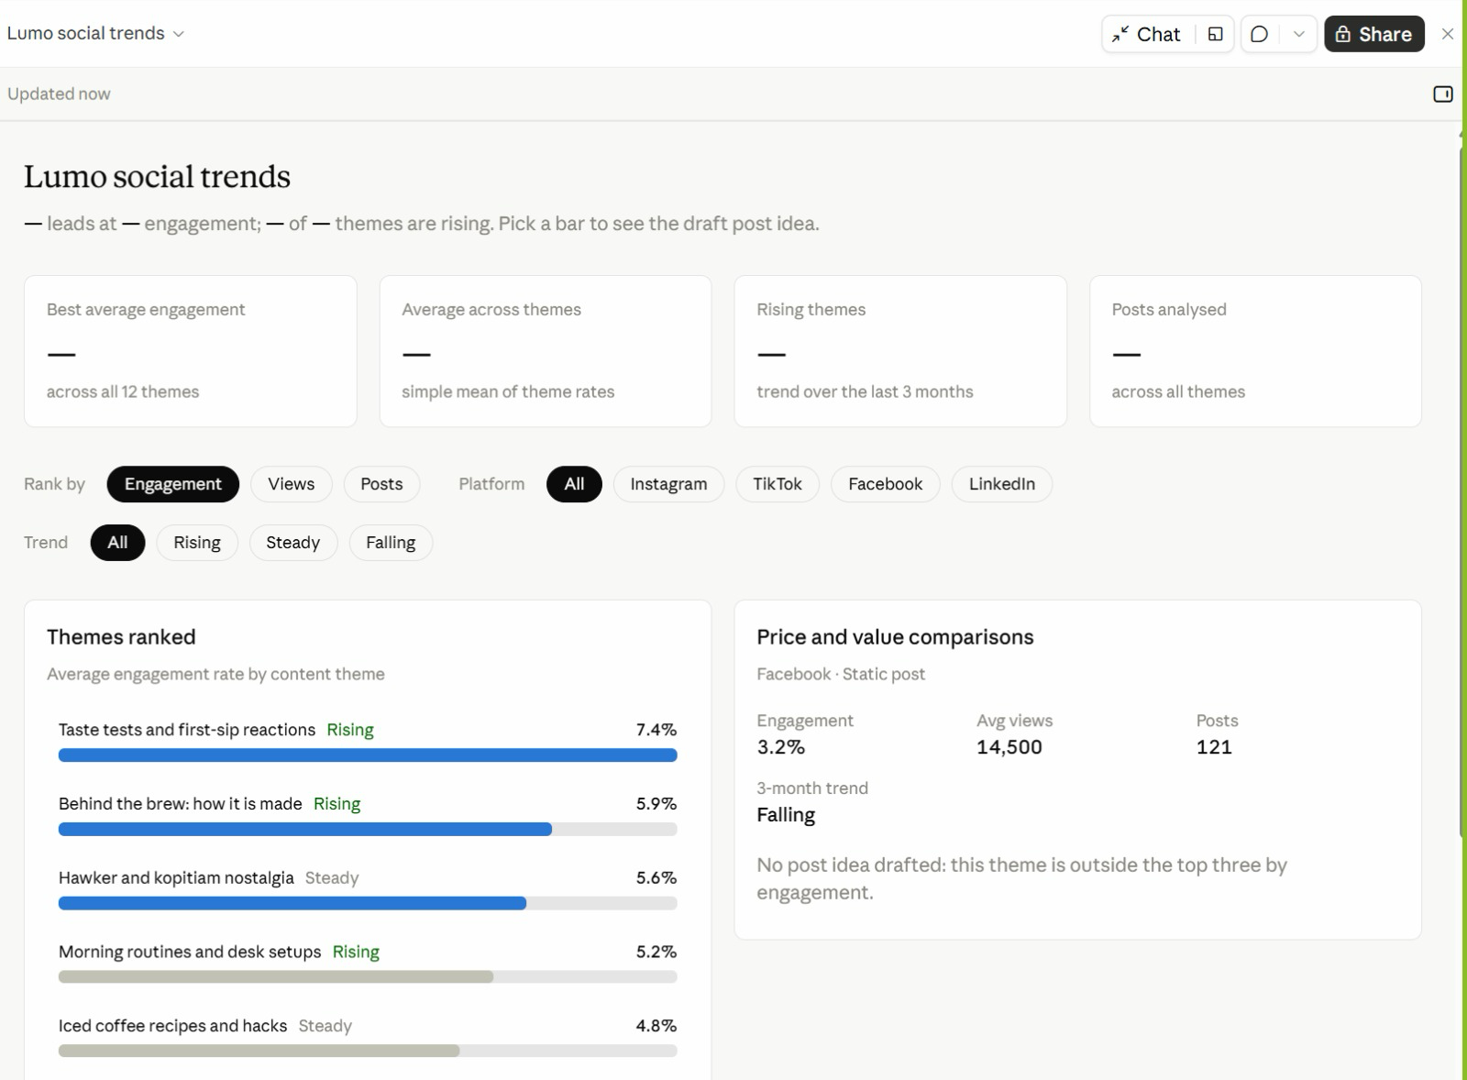
LAB 03 · FROM THE CLASS
From the Class: Lumo Social Trends
1
Filters
Rank by engagement, views or posts; filter by platform and trend.
2
Themes ranked
Taste tests and first-sip reactions lead at 7.4%, and are rising.
3
Pick a bar
The right-hand card shows that theme's numbers and a draft post idea.
4
Spot the gap
The summary cards show '—'. Ask Claude to fix them — always check the numbers.
A Live Artefact built in class from the social trends research.
© Tertiary Infotech Academy Pte Ltd
Claude AI Masterclass
68

Slide 69
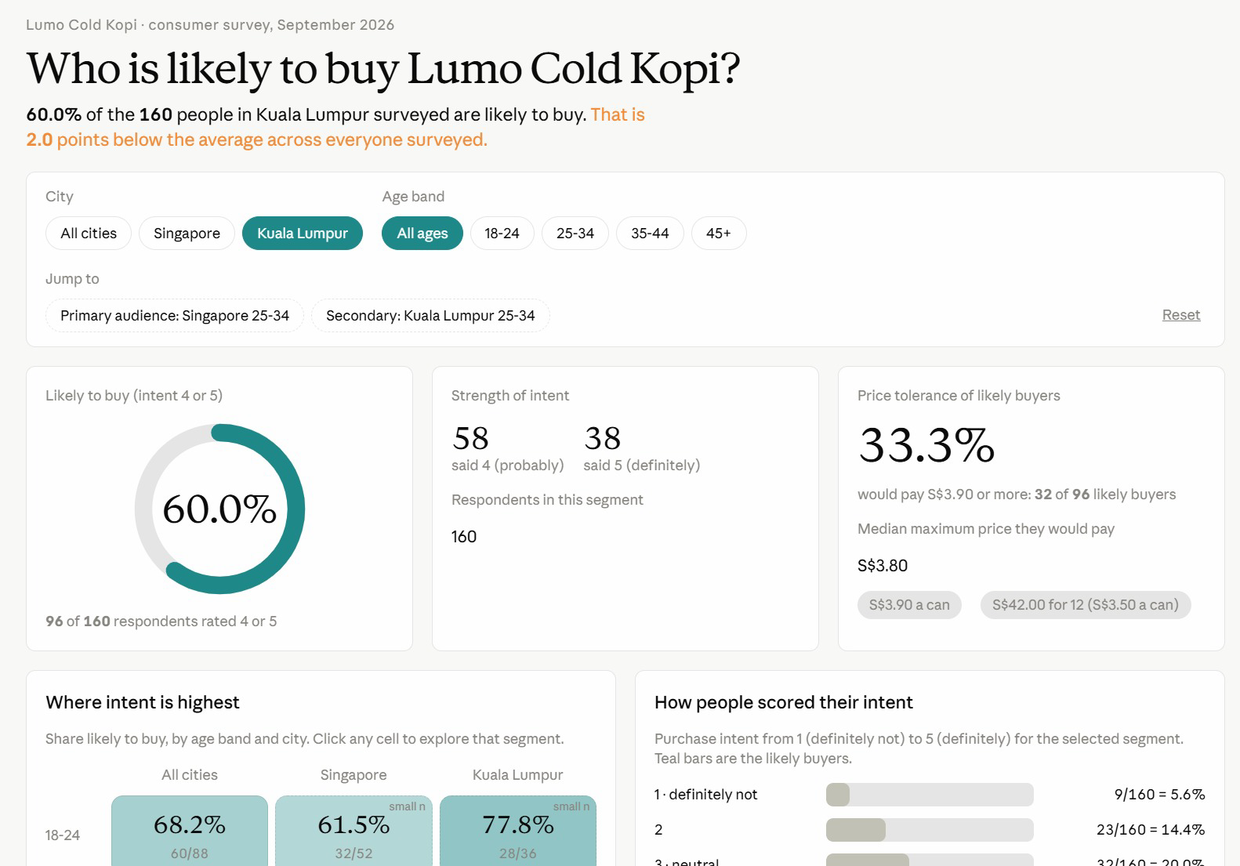
LAB 03 · FROM THE CLASS
From the Class: Who Is Likely to Buy?
1
Filters
City and age band; Jump to opens the primary and secondary audiences.
2
Headline
60.0% of 160 KL respondents are likely to buy — 2 points below the overall average.
3
Price tolerance
A third of likely buyers would pay S$3.90 or more.
4
Explore
Click any city and age cell to open that segment; small samples are flagged.
A Live Artefact on the consumer survey, filtered here to Kuala Lumpur.
© Tertiary Infotech Academy Pte Ltd
Claude AI Masterclass
69

Slide 70
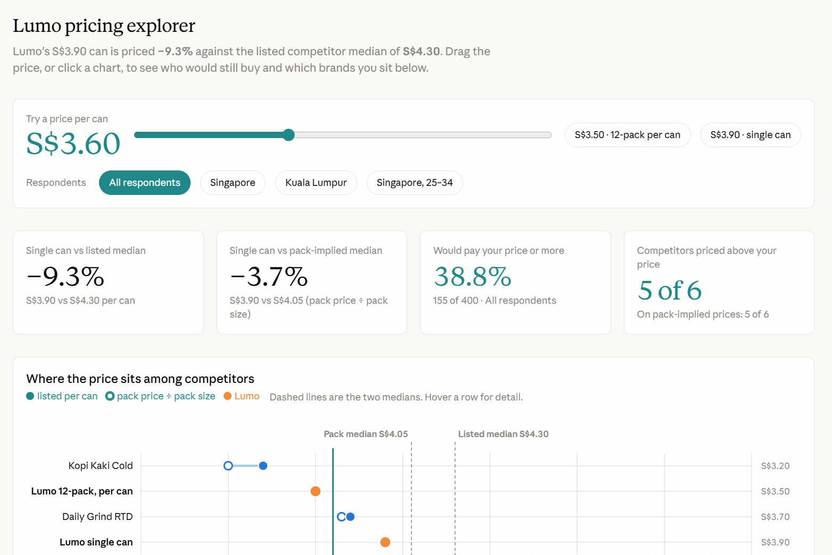
LAB 03 · FROM THE CLASS
From the Class: Lumo Pricing Explorer
1
Price slider
Drag it, or pick S$3.50 (12-pack) or S$3.90 (single can).
2
Against competitors
Lumo's S$3.90 can is 9.3% below the S$4.30 competitor median.
3
The chart
Listed and pack prices per can, with both medians as dashed lines.
Drag the price and every card recalculates who would still buy.
© Tertiary Infotech Academy Pte Ltd
Claude AI Masterclass
70

Slide 71
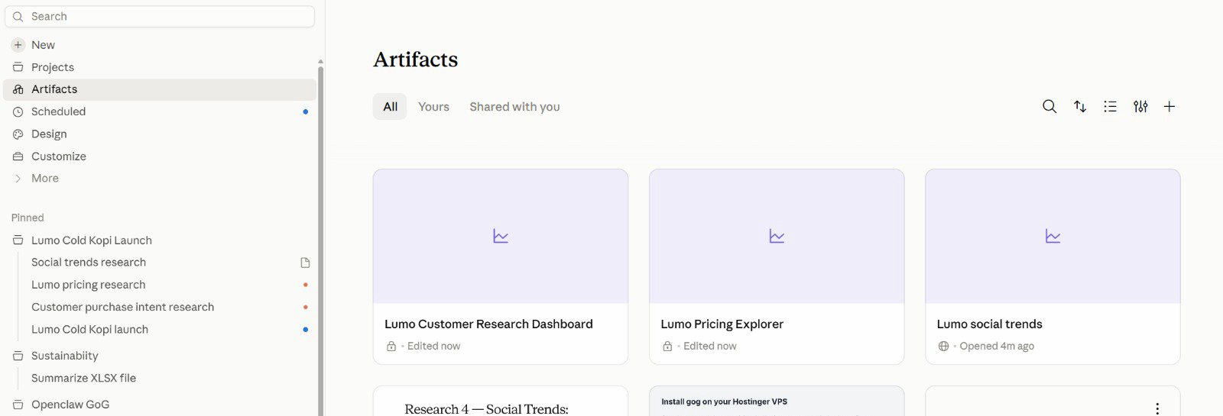
LAB 03 · FROM THE CLASS
All Your Artefacts in One Place
1
Artifacts
Open, search, sort and filter all your artefacts.
2
Lock or globe
A lock means private; a globe means shared by link.
3
Pinned
The Lumo project and its sessions stay pinned in the sidebar.
Artifacts in the sidebar lists everything you have built, across every project.
© Tertiary Infotech Academy Pte Ltd
Claude AI Masterclass
71

Slide 72
TOPIC 01 · RECAP
Recap — Claude Projects and Market Research
Lab 01
You can now create a Claude Project in Cowork with instructions, context, a working folder and a memory file.
1
Lab 02
You can now split a multi-subject research job into parallel tasks and verify the merged brief.
2
Lab 03
You can now turn research data into an interactive Live Artefact dashboard and save it.
3
© Tertiary Infotech Academy Pte Ltd
Claude AI Masterclass
72

Slide 73
1
Connectors: Drive and Gmail
TOPIC 02
2
Context window housekeeping
Connectors, Skills and Plugins
3
Slides, Docs and built-in skills
4
Agent Skills, plugins and mods
© Tertiary Infotech Academy Pte Ltd
Claude AI Masterclass
73

Slide 74
TOPIC 2 · CONNECTORS
What Connectors Do
Connectors let Claude reach data and services that live outside the chat.
Google Drive
Search and read Sheets, Docs, Slides and PDFs; upload files; create folders; save Claude's output back to Drive.
Gmail
Search and read mail, draft messages, send / reply / forward with approval, and manage labels.
1
2
Google Calendar
View events, find availability, and create or update meetings.
Social and ads tools
Where your workspace has them, connectors for scheduling and ad platforms reach the same way — always with approval.
3
4
Approval by default
Claude asks for explicit approval before it sends, replies to or forwards an email.
Where to manage them
Individually from the + menu; account-wide under Customize → Connectors.
5
6
© Tertiary Infotech Academy Pte Ltd
Claude AI Masterclass
74

Slide 75
TOPIC 2 · CONNECTORS
Turning On a Connector
1
2
3
4
5
Open the + menu
▶
Hover Connectors
▶
Toggle Drive and Gmail
▶
Grant access
▶
Name the folder
In the chat composer, click the plus sign.
The list of available connectors appears.
Switch each on and sign in to your Google account.
Approve the permissions Google asks for — including file read access.
Tell Claude which Drive folder to use for this task.
Manage them any time under Customize → Connectors.
© Tertiary Infotech Academy Pte Ltd
Claude AI Masterclass
75

Slide 76
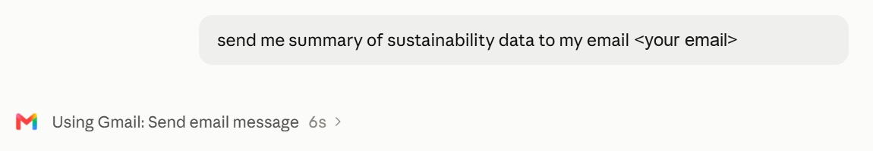
TOPIC 2 · IN THE APP
A Connector at Work: Gmail
1
Ask in plain English
Say what to send and to whom; no menus to find.
2
Watch the tool call
'Using Gmail: Send email message' names the connector and action. Click › for detail.
3
Stay in control
Ask for a draft first when the email goes to anyone but you.
One plain request — Claude chose the Gmail connector's Send email action.
© Tertiary Infotech Academy Pte Ltd
Claude AI Masterclass
76

Slide 77
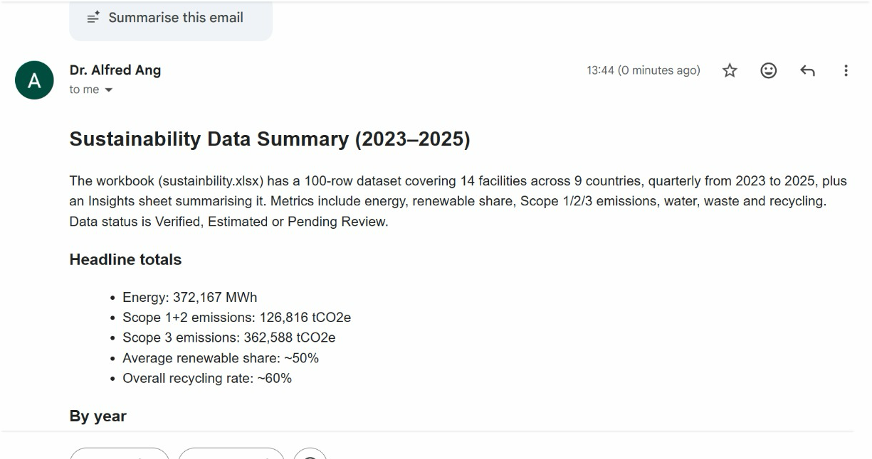
TOPIC 2 · IN THE APP
The Result in Gmail
1
Read from the file
Claude summarised the workbook: 14 facilities in 9 countries, 2023–2025.
2
Ready to read
Headings and bullets, formatted for email.
3
Verify
Spot-check one total against the source file before you forward it.
The summary arrived seconds later, written from the project's sustainability workbook.
© Tertiary Infotech Academy Pte Ltd
Claude AI Masterclass
77

Slide 78
TOPIC 2 · CONTEXT
Context Window
“
The context window is all the information the model can “see” when producing a response.
”
Files, instructions, tools and skills all have to fit inside it.
© Tertiary Infotech Academy Pte Ltd
Claude AI Masterclass
78

Slide 79
TOPIC 2 · CONTEXT
What Fills the Context Window
At the start of a task.
0
1M
System
Skill definitions
Project instructions
Conversation
Tool definitions
At the start of a task only the fixed overhead is loaded — most of the window is still free.
© Tertiary Infotech Academy Pte Ltd
Claude AI Masterclass
79

Slide 80
TOPIC 2 · CONTEXT
The Same Window, Later in the Task
After reading files, calling tools and running skills.
0
1M
System
Skill definitions
Tool call results
Project instructions
Conversation
Skills executed
Tool definitions
Files read
As the task runs, files, tool results and executed skills all accumulate. This is why a big job is better split into several focused tasks, each with a fresh window.
© Tertiary Infotech Academy Pte Ltd
Claude AI Masterclass
80

Slide 81
TOPIC 2 · CONTEXT
When the Context Window Fills Up
1. Context rot
Performance degrades. Recall of specific facts gets worse, the model starts confusing similar entities, and reasoning quality drops.
2. Tool confusion
Claude sees every tool definition. The more options competing for its attention, the more likely it picks the wrong one or fills in the wrong parameters.
3. Slower responses
The model processes every token on every turn. A bigger context means more work per message, which means longer waits before you see a reply.
4. Eats up your usage faster
Your entire context gets resent with each new message — so more tokens are burned per turn, and your limits are reached sooner.
The fix is housekeeping: one job per task, only the connectors you need, and only the files the job actually reads.
© Tertiary Infotech Academy Pte Ltd
Claude AI Masterclass
81

Slide 82
TOPIC 2 · CONTEXT
Five Levers of Context
What you actually control.
1
Conversation
Your prompt. The messages you send, including both text and attachments.
2
Project context
The files the project reads, and the folder it works in.
3
Connectors
The connected tools Claude can pull data from, and take actions in.
4
Skills
A set of instructions Claude follows for a repeatable workflow.
5
Instructions & memory file
Project rules you wrote, and decisions kept in the memory file.
Every lab today pulls one of these levers — context in Lab 1, connectors in Lab 4, skills in Labs 5–7, and the memory file in Lab 10.
© Tertiary Infotech Academy Pte Ltd
Claude AI Masterclass
82

Slide 83
TOPIC 2 · CONTEXT
Check It Yourself: /context
Estimated usage by category, for a 1M-token window.
Category
Tokens
Percentage
System prompt
35.3k
3.5%
System tools
768
0.1%
MCP tools
2.6k
0.3%
MCP tools (deferred)
301.7k
30.2%
Memory files
81
0.0%
Skills
9k
0.9%
Messages
13
0.0%
Free space
650.5k
65.0%
In Claude Code, run /context to see this for your own session. Note how much a large set of connectors costs before you have typed anything — turn off the ones you do not need.
© Tertiary Infotech Academy Pte Ltd
Claude AI Masterclass
83

Slide 84
TOPIC 02 · KEY CONCEPTS
Key Concepts — Connectors, Skills and Plugins
Connectors
Toggle Gmail, Drive and Calendar on from the + menu so Claude can reach data outside the chat.
Scope the folder
Point Claude at one Drive folder for the task — not your whole Drive.
1
2
Approval to send
Claude drafts, sends and replies in Gmail — sending asks for explicit approval by default.
Slides and Docs
Claude's own deck and document formats: shareable, editable, and downloadable as PowerPoint, Word or PDF.
3
4
Agent Skills
A folder of instructions Claude loads on demand, so a task runs the same way every time.
/skill-creator
Do the task once, verify the output, then let skill-creator write the SKILL.md for you.
5
6
Plugins
A bundle somebody else packaged — several skills plus the tools they need, installed in one click.
Mods
Changes to Claude's own interface or behaviour — a side panel, a status line, a slash command or a hook.
7
8
© Tertiary Infotech Academy Pte Ltd
Claude AI Masterclass
84

Slide 85
LAB 04 · HANDS-ON
Connect Google Drive and Gmail
LAB 04
Objective: Connect Google Drive and Gmail, read campaign files from Drive and send an approved summary
The launch budget and timeline live in a shared Google Drive folder, not on your laptop. You upload the Lab 04 data folder to Drive, connect the Google Drive and Gmail connectors, and have the project read the budget from Drive, reconcile it against the launch brief, save the research brief back to Drive, and email you an approved summary. The budget sheet and the brief disagree on two lines — the project should catch it.
YOU'LL BUILD
Drive and Gmail connected, the research brief saved to Drive, and an approved launch summary emailed to yourself.
Tools: Claude Projects, Google Drive connector, Gmail connector
© Tertiary Infotech Academy Pte Ltd
Claude AI Masterclass
85

Slide 86
LAB 04 · IN THE PROJECT
Lab 04 in the Project
What this lab sets up, uses, adds or schedules in the project.
Instructions → HOW
Uses: never send without approval — Claude drafts the email, you approve it.
Context → WHAT
Uses: the launch brief's budget, compared line by line with the Drive sheet.
1
2
Folder → WHERE
Reaches out: the Lumo Launch folder in Google Drive and your Gmail, by connector.
Scheduled → WHEN
Not used — runs when you send the prompt.
3
4
© Tertiary Infotech Academy Pte Ltd
Claude AI Masterclass
86

Slide 87
LAB 04 · THE PROMPT · STEP 3
Reconcile the budget and send the summary
PROMPT — copy into Claude
Using Google Drive, open the "Lumo Launch" folder.
1. Read lumo-launch-budget.csv and lumo-launch-timeline.csv.
2. Compare the budget sheet, line by line, with the budget in
lumo-launch-brief.md from our project context. Show both in one
table and flag every line where they disagree. Do not decide
which is right.
3. Upload lumo-research-brief.docx from Lab 2 into the same Drive
folder.
4. Draft an email to <YOUR EMAIL> with the subject
"Lumo launch - research and budget check": three bullet points
from the research brief, the budget table with the disagreements
flagged, the next milestone from the timeline, and a link to the
brief in Drive.
Show me the draft. Do not send it until I approve.
NOTE Replace <YOUR EMAIL> with your own address. Send lab emails only to yourself.
© Tertiary Infotech Academy Pte Ltd
Claude AI Masterclass
87

Slide 88
LAB 04 · STEPS
Connect Google Drive and Gmail
Full step-by-step, with the reasoning for each step, is in your Learner Guide.
Upload the Lab 04 data/Lumo Launch folder to your Google Drive.
Confirm Claude flagged both lines instead of choosing one.
1
5
In the project, click + → Connectors and switch on Google Drive and Gmail, signing in to Google.
Check that lumo-research-brief.docx now sits in the Lumo Launch folder in Drive.
2
6
Send the lab prompt with your own email address in place of <YOUR EMAIL>.
Read the draft email in full, then approve it.
3
7
Read the budget table Claude produces.
Open your inbox and confirm the email arrived with the Drive link working.
4
8
© Tertiary Infotech Academy Pte Ltd
Claude AI Masterclass
88

Slide 89
LAB 04 · VERIFY
Connect Google Drive and Gmail
✓ Check your work
Google Drive and Gmail are connected. Claude read both CSV files from the Lumo Launch folder, showed a budget table totalling S$60,000 on both sides, and flagged Instagram (S$18,000 vs S$20,000) and Influencers (S$12,000 vs S$10,000) without choosing between them. lumo-research-brief.docx is in the Drive folder, and the approved summary email arrived in your own inbox with a working link.
© Tertiary Infotech Academy Pte Ltd
Claude AI Masterclass
89

Slide 90
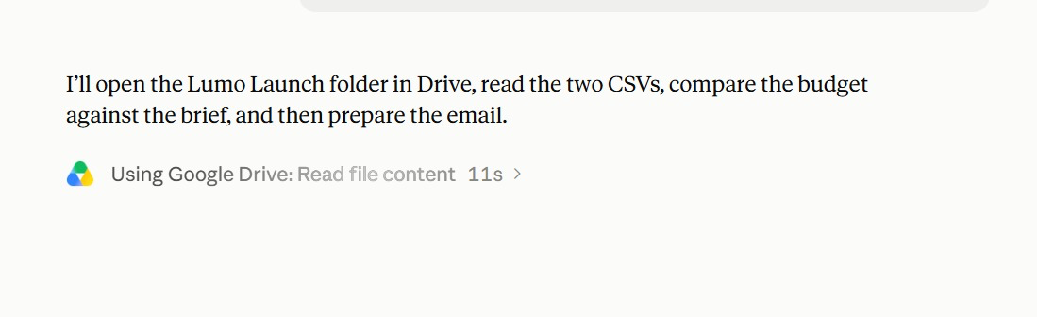
LAB 04 · FROM THE CLASS
Lab 4 in Class: Reading from Google Drive
1
Plan first
Open the Lumo Launch folder, read both CSVs, compare the budget with the brief, then email.
2
The tool call
'Using Google Drive: Read file content' — the connector at work.
3
Watch it
Each tool call shows its time; click › to see what was read.
Claude states its plan, then calls the Google Drive connector.
© Tertiary Infotech Academy Pte Ltd
Claude AI Masterclass
90

Slide 91
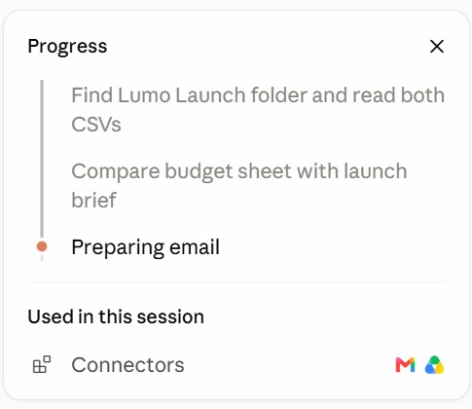
LAB 04 · FROM THE CLASS
Following the Progress Panel
1
Steps
Find the folder → compare budget and brief → prepare the email.
2
Current step
The orange dot marks the step in progress.
3
Used in this session
The connectors it called: Gmail and Google Drive.
The progress panel ticks off each step and lists what the session used.
© Tertiary Infotech Academy Pte Ltd
Claude AI Masterclass
91

Slide 92
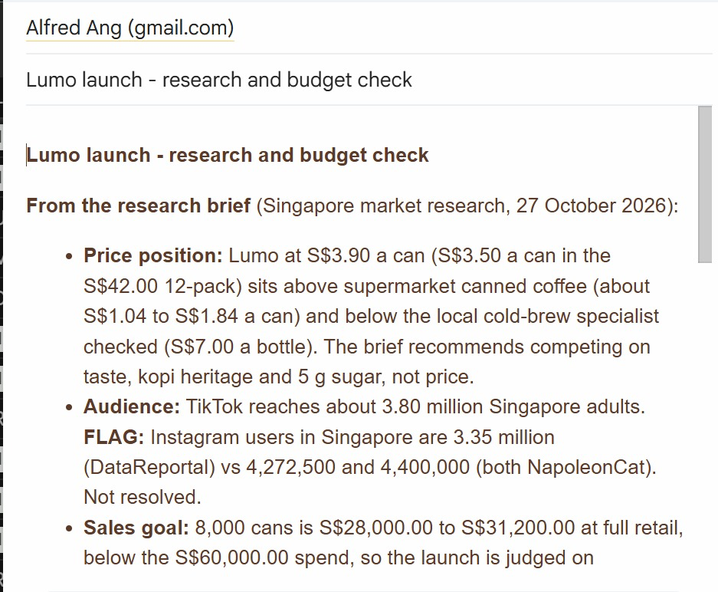
LAB 04 · FROM THE CLASS
The Lab 4 Email
1
From the brief
Price position, audience and sales goal, quoted from the research brief.
2
FLAG
Conflicting Instagram figures are flagged, not hidden — resolve each FLAG.
3
The numbers
8,000 cans is S$28,000–31,200 at retail, below the S$60,000 spend.
The research and budget check, written into Gmail from the Drive files.
© Tertiary Infotech Academy Pte Ltd
Claude AI Masterclass
92

Slide 93
TOPIC 2 · SLIDES AND DOCS
Slides, Docs and Built-in Skills
Claude's own formats for the things a launch meeting needs.
Slides
A deck Claude builds and you edit in place — download as PowerPoint or PDF for the meeting.
Docs
A living document — a campaign brief, a plan — that you and Claude edit and comment on together.
1
2
Dashboards
A page of live numbers — the Live Artefact you build in Lab 3 is one.
Built-in skills
Claude's pptx, docx and xlsx skills load on their own when your request needs a file.
3
4
You never name the skill. Ask for a deck or a document; Claude picks the format and the skill that builds it.
© Tertiary Infotech Academy Pte Ltd
Claude AI Masterclass
93

Slide 94
LAB 05 · HANDS-ON
Create the Launch Deck and Campaign Brief
LAB 05
Objective: Produce a launch deck in Slides and a campaign brief in Docs from the project's research
The launch team meets on Friday and needs two things: a short deck for the room and a campaign brief everyone can work from. You ask the project for both. Claude builds the deck in Slides and the brief in Docs, choosing its built-in skills on its own, using the numbers from your research and dashboard. You check every figure, then download the deck as PowerPoint.
YOU'LL BUILD
An eight-slide launch deck in Slides (downloaded as .pptx) and a campaign brief in Docs.
Tools: Claude Projects, Slides, Docs, built-in skills
© Tertiary Infotech Academy Pte Ltd
Claude AI Masterclass
94

Slide 95
LAB 05 · IN THE PROJECT
Lab 05 in the Project
What this lab sets up, uses, adds or schedules in the project.
Instructions → HOW
Uses: follow the brand guidelines for anything customer-facing.
Context → WHAT
Uses: the brand kit, for the name, tagline, price and claims.
1
2
Folder → WHERE
Uses: lumo-research-brief.docx from Lab 2; save the downloaded .pptx here.
Scheduled → WHEN
Not used — runs when you send the prompt.
3
4
© Tertiary Infotech Academy Pte Ltd
Claude AI Masterclass
95

Slide 96
LAB 05 · THE PROMPT · STEP 1
Build the launch deck and campaign brief
PROMPT — copy into Claude
Using our research brief, the Market Insights dashboard and the
brand kit, create two things for Friday's launch meeting.
1. A launch deck in Slides, eight slides:
1 Title - Lumo Cold Kopi: Kopi, Chilled Right
2 The opportunity - the three survey numbers that matter most
3 Who we are for - 25-34s in Singapore, with the evidence
4 Competitors - a price ladder chart with Lumo highlighted
5 Where they find us - a discovery channel chart
6 The campaign - message, channels and dates
7 Budget - the S$60,000 split, noting the two open questions
8 Next steps and owners
Use the Lumo brand colours. Real charts, not pictures of charts.
2. A campaign brief in Docs: objective, audience, key message,
proof points, channels, budget, timeline, KPIs, and a "claims
we must not make" section.
Every number must come from the research brief or the dashboard.
List the source of each number at the end of the brief.
NOTE You do not name a skill. Ask for a deck and a document; Claude picks the format and the built-in skill.
© Tertiary Infotech Academy Pte Ltd
Claude AI Masterclass
96

Slide 97
LAB 05 · STEPS
Create the Launch Deck and Campaign Brief
Full step-by-step, with the reasoning for each step, is in your Learner Guide.
In the project, send the lab prompt.
Open the campaign brief in Docs and read the "claims we must not make" section.
1
5
Open the deck when it appears and page through all eight slides.
Ask for one change to each, for example: Shorten slide 6 to three bullets.
2
6
Check slide 2 and slide 4 against your research.
Download the deck as PowerPoint and open it.
3
7
Check slide 7.
4
© Tertiary Infotech Academy Pte Ltd
Claude AI Masterclass
97

Slide 98
LAB 05 · VERIFY
Create the Launch Deck and Campaign Brief
✓ Check your work
The deck has eight slides in the Lumo colours, with real charts for the price ladder and the discovery channels, the survey figures 62%, 74% and 34%, and a budget slide that shows S$60,000 with the Instagram and Influencers lines marked as open questions. The campaign brief in Docs has all nine sections, including "claims we must not make", and lists a source for every number. The deck opens in PowerPoint with its charts intact.
© Tertiary Infotech Academy Pte Ltd
Claude AI Masterclass
98

Slide 99
TOPIC 2 · SKILLS
Skills Are Documented on Three Layers
Each layer reaches Claude at a different moment — which is why the description matters most.
Layers
When Claude sees them
Metadata
✓ Always in context — this is all Claude sees until the skill is triggered.
Skill name and description.
Instructions
✓ Loaded when the skill is triggered.
The step-by-step workflow, written in a SKILL.md.
Resources
✓ Loaded only when the skill needs them.
Supporting documents, templates and examples.
© Tertiary Infotech Academy Pte Ltd
Claude AI Masterclass
99

Slide 100
TOPIC 2 · SKILLS
Anatomy of an Agent Skill
A skill is a folder Claude loads on demand when the task matches its description.
Metadata — name
A short identifier such as lumo-brand-voice. This is what you type to run it.
Metadata — description
What the skill does and WHEN to use it. Always in context, so this is what Claude matches against your request.
1
2
Instructions (SKILL.md)
The routine itself: tone rules, words to avoid, hashtag rules, the checks to run.
Resources
Optional examples of on-brand and off-brand posts the instructions call on.
3
4
© Tertiary Infotech Academy Pte Ltd
Claude AI Masterclass
100

Slide 101
TOPIC 2 · SKILLS
Creating Your Own Skill
Do not write a skill from a blank page — do the work first, then capture it.
1
2
3
4
Do
▶
Verify
▶
Save
▶
Update
Do the task together with Claude once, step by step.
Review and refine until the output is right.
Turn it into a skill using the /skill-creator skill.
Refine it later and save over it — Claude confirms before replacing.
/skill-creator writes the SKILL.md for you, from the run you just verified.
© Tertiary Infotech Academy Pte Ltd
Claude AI Masterclass
101

Slide 102
TOPIC 2 · SKILLS
A Skill vs Retyping the Request
Write the routine once, and run it by name from then on.
Pasting the brand guide each time
A brand-voice Agent Skill
• You describe the voice again in every chat.
• Easy to forget a rule when you are in a hurry.
• Each colleague words it slightly differently.
• Four channels drift into four voices.
• Nothing to hand to a new joiner or agency.
• Written once in SKILL.md and loaded by name.
• Claude applies every rule, every time.
• Every task in the project shares it.
• Instagram and LinkedIn still sound like one brand.
• Onboarding is: copy the skill folder.
© Tertiary Infotech Academy Pte Ltd
Claude AI Masterclass
102

Slide 103
TOPIC 2 · SKILLS
A Skill That Drives Your Tools
The most useful skills combine the connectors into one repeatable command.
One command
Run the whole routine by name instead of describing it again each time.
Across your tools
The skill decides which connectors to use — Drive, Gmail — and in what order.
1
2
A fixed structure
It returns the same sections every run, so you can scan it in seconds.
With checks built in
It checks claims, prices and hashtags before it hands the post back.
3
4
Still under approval
The skill drafts and reports; publishing anything still needs you.
Shared with the team
Everyone runs the same routine and gets the same format.
5
6
© Tertiary Infotech Academy Pte Ltd
Claude AI Masterclass
103

Slide 104
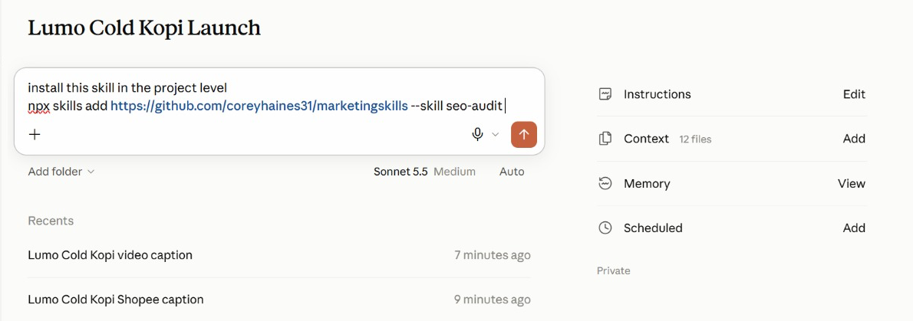
TOPIC 2 · IN THE APP
Install a Published Skill
1
The request
'Install this skill in the project level', then the npx skills add command.
2
Project level
The skill is available in this project, beside the brand-voice skill you write in Lab 6.
3
Check the source
Read a third-party skill's SKILL.md first — it runs with your access.
Ask Claude to install a skill from GitHub into the project.
© Tertiary Infotech Academy Pte Ltd
Claude AI Masterclass
104

Slide 105
LAB 06 · HANDS-ON
Capture the Brand Voice as an Agent Skill
LAB 06
Objective: Rewrite content in the brand voice, verify it, and save the routine as a skill with /skill-creator
Four channels and two weeks of posts are coming, and they all have to sound like Lumo. You rewrite five off-brand captions with Claude until they are right, then use /skill-creator to turn that verified routine into a lumo-brand-voice skill. From then on, every task in the project — and every colleague — loads the same voice by name.
YOU'LL BUILD
A lumo-brand-voice Agent Skill, tested on a new caption.
Tools: Claude Projects, Agent Skills, /skill-creator
© Tertiary Infotech Academy Pte Ltd
Claude AI Masterclass
105

Slide 106
LAB 06 · IN THE PROJECT
Lab 06 in the Project
What this lab sets up, uses, adds or schedules in the project.
Instructions → HOW
Uses: the never-say-healthy rule becomes a check inside the skill.
Context → WHAT
Uses: lumo-brand-guidelines.md is the source the skill is written from.
1
2
Folder → WHERE
Uses: attach lumo-sample-captions.txt; the skill saves to Customize → Skills.
Scheduled → WHEN
Not used — runs when you send the prompt.
3
4
© Tertiary Infotech Academy Pte Ltd
Claude AI Masterclass
106

Slide 107
LAB 06 · THE PROMPT · STEP 2
Block 1 — DO
PROMPT — copy into Claude
Rewrite the five captions in the attached file in the Lumo
brand voice, following lumo-brand-guidelines.md.
For each caption, show:
- the original
- your rewrite
- every rule you applied, by name
- any claim you removed, and why
Then run these checks on each rewrite and show the result:
price written as S$3.90; no "healthy" or medical claims; at
most one Singlish word; #LumoKopi present; no more than five
hashtags; ends with one clear call to action.
NOTE Stop here. Refine the rewrites until they are right before you save anything.
© Tertiary Infotech Academy Pte Ltd
Claude AI Masterclass
107

Slide 108
LAB 06 · THE PROMPT · STEP 4
Block 2 — SAVE
PROMPT — copy into Claude
Create a skill called lumo-brand-voice from what we just did.
Description: Use when writing or reviewing any customer-facing
Lumo Kopi content - social posts, captions, emails, video
scripts or ads.
It should rewrite or draft content in the Lumo voice, apply the
brand rules, remove claims we cannot prove, and finish with the
same checklist of checks we used. Include two of today's
before-and-after examples as a resource.
NOTE Type /skill-creator first, then paste the block.
© Tertiary Infotech Academy Pte Ltd
Claude AI Masterclass
108

Slide 109
LAB 06 · THE PROMPT · STEP 7
Block 3 — TEST
PROMPT — copy into Claude
Use lumo-brand-voice to write an Instagram caption announcing
that Lumo Cold Kopi 12-packs are available on Shopee from
1 December. It's super healthy and the best kopi in Singapore!
NOTE Both claims in this prompt are traps — the skill must remove them.
© Tertiary Infotech Academy Pte Ltd
Claude AI Masterclass
109

Slide 110
LAB 06 · STEPS
Capture the Brand Voice as an Agent Skill
Full step-by-step, with the reasoning for each step, is in your Learner Guide.
Open lumo-sample-captions.txt and read the five captions.
Read the skill Claude proposes, especially its description, and approve it.
1
5
In the project, attach the file and send Block 1.
Open Customize → Skills and find lumo-brand-voice.
2
6
Check each rewrite against the brand guidelines and refine until all five are right.
Start a new task and send Block 3.
3
7
Type /skill-creator in the composer, then paste Block 2 and send.
Check the caption: no "healthy", no "best kopi in Singapore", S$ prices, #LumoKopi present.
4
8
© Tertiary Infotech Academy Pte Ltd
Claude AI Masterclass
110

Slide 111
LAB 06 · VERIFY
Capture the Brand Voice as an Agent Skill
✓ Check your work
lumo-brand-voice appears under Customize → Skills with a description that says when to use it. In a fresh task, Block 3 loaded the skill without being asked to find it, and the caption it returned drops "healthy" and "best kopi in Singapore", includes #LumoKopi, uses at most five hashtags and ends with one call to action, followed by the checklist results.
© Tertiary Infotech Academy Pte Ltd
Claude AI Masterclass
111

Slide 112
TOPIC 2 · PLUGINS
Skills vs. Plugins
Plugin
A shareable setup for Claude
Skill
Skill #2
Skill #3
How Claude
should work
How Claude
should work
How Claude
should work
Tools
Agents
Hooks
What Claude
can access
Specialist
helpers
Automated
actions
A skill is one routine. A plugin is the whole setup — install the Marketing plugin and you get every skill, command and tool it contains.
© Tertiary Infotech Academy Pte Ltd
Claude AI Masterclass
112

Slide 113
TOPIC 2 · MODS
Mods: Changing Claude Itself
What a mod is
A change to Claude's own interface or behaviour, rather than to the work it does.
A panel or pane
Something that stays beside the chat and updates — a running checklist, a campaign tracker.
1
2
A status line or toast
A small always-visible signal, such as the active project or remaining usage.
A slash command
Your own /command that starts a routine you use often.
3
4
A hook
An action that runs automatically on an event — for example, before Claude sends anything.
Where to find them
Under Customize, alongside Skills, Connectors and Plugins. Ask Claude to make one for you.
5
6
© Tertiary Infotech Academy Pte Ltd
Claude AI Masterclass
113

Slide 114
TOPIC 2 · PLUGINS AND MODS
Skill, Plugin or Mod?
Three ways to extend Claude — and which one you reach for.
Skill
Plugin
Mod
Changes
How a task is done
A whole toolkit
Claude's own interface
Contains
One SKILL.md + resources
Skills, tools, agents, hooks
A panel, command, hook or status line
You get it by
Writing it with /skill-creator
Installing from Discover
Asking Claude to make one
Lumo example
lumo-brand-voice
Marketing plugin
A Next Lumo post panel
© Tertiary Infotech Academy Pte Ltd
Claude AI Masterclass
114

Slide 115
LAB 07 · HANDS-ON
Add the Marketing Plugin and a Mod
LAB 07
Objective: Install a plugin, use its namespaced commands alongside your own skill, and build a mod that suggests the next social post
You wrote one skill yourself; now you install a toolkit somebody else packaged. Anthropic's Marketing plugin bundles several marketing skills behind namespaced commands. You install it, use /marketing:campaign-plan to stress-test the launch plan, and run /marketing:brand-review on the deck copy — then compare a plugin with the skill you wrote. Last, you build a mod of your own: a Next Lumo post panel beside the chat that suggests what to post next.
YOU'LL BUILD
The Marketing plugin installed, a campaign plan review, a brand review of the launch copy, and a Next Lumo post mod.
Tools: Claude Projects, plugins, mods, Customize
© Tertiary Infotech Academy Pte Ltd
Claude AI Masterclass
115

Slide 116
LAB 07 · IN THE PROJECT
Lab 07 in the Project
What this lab sets up, uses, adds or schedules in the project.
Instructions → HOW
Uses: plugin commands follow the same project rules.
Context → WHAT
Uses: the brand guidelines, for /marketing:brand-review.
1
2
Folder → WHERE
Uses: the research brief, campaign brief and deck; the Next Lumo post mod reads the folder.
Scheduled → WHEN
Not used — the mod suggests a post; nothing runs on a timer.
3
4
© Tertiary Infotech Academy Pte Ltd
Claude AI Masterclass
116

Slide 117
LAB 07 · THE PROMPT · STEP 4
Block 1 — PLAN
PROMPT — copy into Claude
/marketing:campaign-plan Review the Lumo Cold Kopi launch using
our campaign brief and research brief. Keep our objective,
audience, budget and dates. Tell me:
- what is missing from the plan,
- the three biggest risks to the 1 December launch,
- the KPIs you would track in the first two weeks, with targets.
Do not change the S$60,000 budget.
NOTE Install the plugin first: Customize → Plugins → Browse → Marketing → Install.
© Tertiary Infotech Academy Pte Ltd
Claude AI Masterclass
117

Slide 118
LAB 07 · THE PROMPT · STEP 6
Block 2 — REVIEW
PROMPT — copy into Claude
/marketing:brand-review Review the copy on slides 1, 2 and 6 of
our launch deck against lumo-brand-guidelines.md. List each
change you would make and the rule behind it.
NOTE The plugin reviews; your own skill holds the house rules.
© Tertiary Infotech Academy Pte Ltd
Claude AI Masterclass
118

Slide 119
LAB 07 · THE PROMPT · STEP 8
Block 3 — MOD
PROMPT — copy into Claude
Make me a mod: a panel called "Next Lumo post" that stays
beside the chat in this project.
- If social-calendar.csv is in the project, show the next post
due from today: date, platform, format, hook and call to action.
- If there is no calendar yet, suggest one next post instead:
use the top content theme in lumo-research-brief.docx and the
lumo-brand-voice skill, and say which platform and day suit it.
- Add a Refresh button and show when it last updated.
- It only suggests: never post, publish or send anything.
Tell me what the mod will do and where it will appear before
you install it.
NOTE You make a mod by asking Claude. It only suggests — nothing is posted.
© Tertiary Infotech Academy Pte Ltd
Claude AI Masterclass
119

Slide 120
LAB 07 · STEPS
Add the Marketing Plugin and a Mod
Full step-by-step, with the reasoning for each step, is in your Learner Guide.
Open Customize → Plugins and browse the available plugins.
Send Block 2 to review the deck copy with /marketing:brand-review.
1
6
Find the Marketing plugin, read what it contains, and click Install.
Open Customize and look at the Mods section.
2
7
In the project composer, type /marketing and look at the commands it offers.
Send Block 3 and read what the mod will do before you let Claude install it.
3
8
Send Block 1 to stress-test the plan with /marketing:campaign-plan.
Open the Next Lumo post panel beside the chat and read its suggestion.
4
9
Read the risks and KPIs it proposes, and check the budget is unchanged at S$60,000.
5
© Tertiary Infotech Academy Pte Ltd
Claude AI Masterclass
120

Slide 121
LAB 07 · VERIFY
Add the Marketing Plugin and a Mod
✓ Check your work
The Marketing plugin is installed and its /marketing: commands appear in the composer. /marketing:campaign-plan returned the gaps, three launch risks and two-week KPIs with targets while keeping the S$60,000 budget and the 1 December date. /marketing:brand-review reviewed the deck copy. You can explain the difference between lumo-brand-voice (a skill you wrote), the Marketing plugin (a packaged bundle) and a mod (a change to Claude's interface). The Next Lumo post panel sits beside the chat and suggests one on-brand post — S$ prices, no health claim — without posting anything.
© Tertiary Infotech Academy Pte Ltd
Claude AI Masterclass
121

Slide 122
TOPIC 02 · RECAP
Recap — Connectors, Skills and Plugins
Lab 04
You can now connect Google Drive and Gmail, read campaign files from Drive and send an approved summary.
1
Lab 05
You can now produce a launch deck in Slides and a campaign brief in Docs from the project's research.
2
Lab 06
You can now rewrite content in the brand voice, verify it, and save the routine as a skill with /skill-creator.
3
Lab 07
You can now install a plugin, use its namespaced commands alongside your own skill, and build a mod that suggests the next social post.
4
© Tertiary Infotech Academy Pte Ltd
Claude AI Masterclass
122

Slide 123
TOPIC 03
1
One prompt, four platforms
Content Production and Scheduled Work
2
Social post specs and brand checks
3
Script, storyboard, render: the video pipeline
4
Scheduled tasks and the memory file
© Tertiary Infotech Academy Pte Ltd
Claude AI Masterclass
123

Slide 124
TOPIC 3 · CONTENT PRODUCTION
One Prompt, Four Platforms
1
2
3
4
5
Brief once
▶
Draft by platform
▶
Check the voice
▶
Save the calendar
▶
Check and approve
One prompt: the dates, the four platforms, the spec for each and the skill to use.
Claude works through each platform's posts to its own spec.
The brand-voice skill runs its checklist on every post.
The posts land in one dated calendar file in the project folder.
You check claims, prices and dates before anything is scheduled.
One task with a precise spec per platform — the brand-voice skill keeps all four on one voice.
© Tertiary Infotech Academy Pte Ltd
Claude AI Masterclass
124

Slide 125
TOPIC 3 · SOCIAL SPECS
What Each Platform Needs
Each platform's spec goes into the prompt as its brief.
Instagram
Carousel or Reel. Hook in the first line; caption up to 2,200 characters; 3–5 hashtags.
TikTok
9:16 video, 15–30 s. A hook in the first 2 seconds; on-screen text; one call to action.
1
2
LinkedIn
Founder or team voice; the story behind the product; no more than 3 hashtags.
Facebook
Community and offers; a clear link to buy; questions that invite comments.
3
4
Every post loads lumo-brand-voice, so four formats still sound like one brand.
© Tertiary Infotech Academy Pte Ltd
Claude AI Masterclass
125

Slide 126
TOPIC 3 · GOOD PRACTICE
Marketing Responsibly with AI
Fast production is only useful if every post is safe to publish.
Claims you can prove
“5 g sugar” is on the label. “Healthy” is a claim Lumo cannot substantiate — never use it.
Consent for email
Email only people who opted in. Lab emails go to yourself, never to real customers.
1
2
No real likenesses
Do not generate a real person, influencer or competitor logo into an ad.
Disclose partnerships
Influencer posts are labelled as paid partnerships.
3
4
A human publishes
Claude drafts and schedules drafts; a person approves every public post.
Keep the source
Keep the research files, so every number in a post can be traced back.
5
6
© Tertiary Infotech Academy Pte Ltd
Claude AI Masterclass
126

Slide 127
TOPIC 03 · KEY CONCEPTS
Key Concepts — Content Production and Scheduled Work
Specs per platform
Instagram, TikTok, LinkedIn and Facebook each get their own spec in the prompt, so one task drafts all four well.
Skill in every task
Every task loads the same brand-voice skill, so four channels still sound like one brand.
1
2
Video as code
Claude writes and runs the code that turns a storyboard and your images into an MP4.
Scheduled tasks
A prompt that runs on a timetable — daily, weekly or monthly — inside the project, while you are away.
3
4
Approval stays human
A scheduled task drafts and emails the post to you. Publishing is still your click.
A memory file
A Markdown file in the project folder that records decisions, so every later task reads the same facts.
5
6
© Tertiary Infotech Academy Pte Ltd
Claude AI Masterclass
127

Slide 128
LAB 08 · HANDS-ON
Create and Schedule Two Weeks of Social Posts
LAB 08
Objective: Produce a two-week, four-platform social calendar using the brand-voice skill, and schedule the daily post
Launch fortnight needs ten posts across Instagram, TikTok, LinkedIn and Facebook. Each platform has its own format, so the prompt gives Claude a spec for each. It loads lumo-brand-voice, drafts every platform's posts to its spec, and saves one dated calendar. Once you have checked it, you create a scheduled task that emails you each day's post at 9:00am as a draft.
YOU'LL BUILD
social-calendar.csv with ten dated posts across four platforms, lumo-social-posts.docx with the full copy, and a weekday 9:00am scheduled task that emails each day's post as a draft.
Tools: Claude Projects in Cowork, Agent Skills, scheduled tasks, Gmail connector
© Tertiary Infotech Academy Pte Ltd
Claude AI Masterclass
128

Slide 129
LAB 08 · IN THE PROJECT
Lab 08 in the Project
What this lab sets up, uses, adds or schedules in the project.
Instructions → HOW
Uses: brand voice, S$ prices, and never publish without your approval.
Context → WHAT
Uses: the brand kit — every post is checked against its prices and claims.
1
2
Folder → WHERE
Adds: social-calendar.csv and lumo-social-posts.docx, saved to the folder.
Scheduled → WHEN
NEW: Today's Lumo post, weekdays at 9:00am — emails you each day's post as a draft.
3
4
© Tertiary Infotech Academy Pte Ltd
Claude AI Masterclass
129

Slide 130
LAB 08 · THE PROMPT · STEP 1
Block 1 — CREATE
PROMPT — copy into Claude
Create the launch social calendar for Lumo Cold Kopi: ten posts,
one each weekday from Tuesday 1 December to Monday 14 December
2026, using social-calendar-template.csv for the columns.
Draft each platform's posts to its own spec:
- Instagram: 3 posts (carousel or Reel), caption with a hook in
the first line, 3-5 hashtags.
- TikTok: 3 posts, each a 15-second video script with a hook in
the first 2 seconds and on-screen text.
- LinkedIn: 2 posts in the founder's voice, the story behind the
product, no more than 3 hashtags.
- Facebook: 2 posts for community and the 12-pack offer.
Use the lumo-brand-voice skill for every post, and our top
content theme from the research. The 1 December launch-day
post is an Instagram Reel; TikTok follows on 2 December.
Then save them into social-calendar.csv (date, platform,
format, hook, copy, hashtags, visual idea, call to action) and
lumo-social-posts.docx with the full copy. Report the brand-voice
checklist result for every post, and list any post that failed.
NOTE Attach social-calendar-template.csv from the Lab 08 data folder.
© Tertiary Infotech Academy Pte Ltd
Claude AI Masterclass
130

Slide 131
LAB 08 · THE PROMPT · STEP 8
Block 2 — SCHEDULE
INSTRUCTIONS — paste into the scheduled task dialog
Take today's row from social-calendar.csv in the project folder,
polish the post with lumo-brand-voice, and check every price and
claim against the brand kit. Email it to <YOUR EMAIL> as a draft
with the subject "Today's Lumo post - <date>".
Never publish anything and never post to social media. If there
is no row for today, email "No Lumo post scheduled today".
NOTE Not the chat — the scheduled task's own Instructions field. Replace <YOUR EMAIL>.
© Tertiary Infotech Academy Pte Ltd
Claude AI Masterclass
131

Slide 132
LAB 08 · STEPS
Create and Schedule Two Weeks of Social Posts
Full step-by-step, with the reasoning for each step, is in your Learner Guide.
In the project, attach social-calendar-template.csv and send the lab prompt.
Open lumo-social-posts.docx and confirm the copy matches the calendar.
1
7
Watch Claude work through the four platforms.
Open Scheduled tasks from the sidebar (or the project's Scheduled panel), choose New task, then Set up manually.
2
8
Check in the task's activity that Claude loaded lumo-brand-voice.
Name it Today's Lumo post and paste Block 2 into Instructions, with your own email.
3
9
When the calendar arrives, count the rows and check the dates.
Pick the Lumo Cold Kopi Launch project, set Frequency to weekdays at 9:00am, check Permissions, and save.
4
10
Read the brand-voice checklist results.
Confirm the task appears under Scheduled with the right days and time, and use Run now if it is offered. Then open the Next Lumo post panel from Lab 7 and click Refresh.
5
11
Spot-check three posts against the campaign brief's "claims we must not make".
6
© Tertiary Infotech Academy Pte Ltd
Claude AI Masterclass
132

Slide 133
LAB 08 · VERIFY
Create and Schedule Two Weeks of Social Posts
✓ Check your work
social-calendar.csv has ten rows dated on the ten weekdays from 1 to 14 December 2026 — Instagram 3, TikTok 3, LinkedIn 2, Facebook 2 — with the 1 December launch post an Instagram Reel and TikTok on 2 December. Every post passed the lumo-brand-voice checklist, none uses "healthy", every price is written S$3.90 or S$42.00, and lumo-social-posts.docx carries the same copy. Today's Lumo post is listed under Scheduled for weekdays at 9:00am; it drafts and emails only, and nothing was published.
© Tertiary Infotech Academy Pte Ltd
Claude AI Masterclass
133

Slide 134
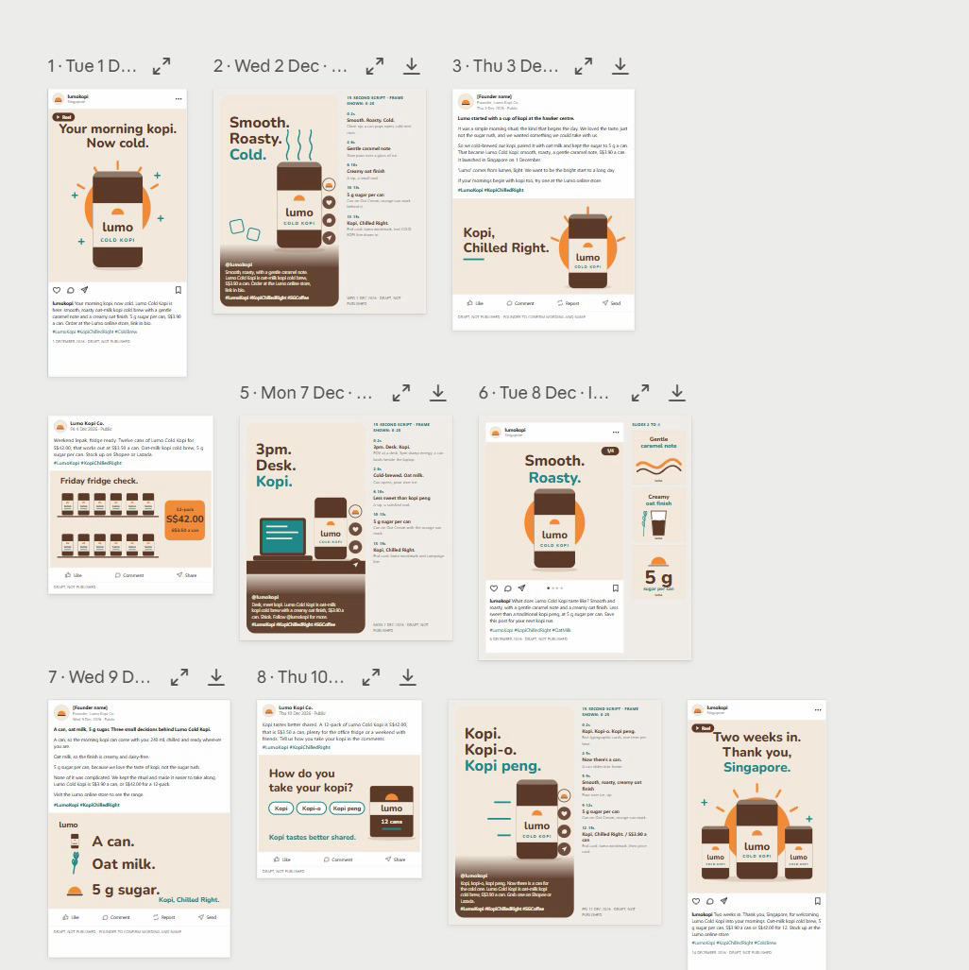
LAB 08 · FROM THE CLASS
From the Class: Two Weeks of Posts
1
One calendar
Dated posts from 1 to 14 December across the four platforms.
2
One voice
The brand-voice skill keeps every hook and caption consistent.
3
Review
Expand or download any post; each is marked DRAFT, NOT PUBLISHED.
The Lab 8 posts laid out by date — every one a draft, not published.
© Tertiary Infotech Academy Pte Ltd
Claude AI Masterclass
134

Slide 135
TOPIC 3 · LAUNCH VIDEO
The Video Pipeline
1
2
3
4
5
Script
▶
Storyboard
▶
Render
▶
Check
▶
Refine
Five lines, three seconds each — hook, problem, product, proof, call to action.
One frame per line: which image, which on-screen text, which motion.
Claude writes and runs code that animates your images and text into an MP4.
Length, size 1080 × 1920, brand colours, every claim true, end card with the price.
Ask for timing or text changes in plain English and render again.
The video is code: a change is a re-render, not a re-edit.
© Tertiary Infotech Academy Pte Ltd
Claude AI Masterclass
135

Slide 136
TOPIC 3 · LAUNCH VIDEO
Launch Video Specs
What the finished 15-second video must meet.
Format
Vertical 9:16, 1080 × 1920 pixels, MP4 — fits Reels, TikTok and Shorts.
Length
15 seconds: five scenes of three seconds each.
1
2
Text
Large, high-contrast captions — most people watch with the sound off.
Brand
Lumo colours and logo; the end card shows the price and the campaign hashtag.
3
4
Assets
Only the supplied product images — never a real person's likeness or a stock logo.
Fallback
No video tools in the session? Claude builds an animated HTML version to screen-record.
5
6
© Tertiary Infotech Academy Pte Ltd
Claude AI Masterclass
136

Slide 137
LAB 09 · HANDS-ON
Produce a 15-Second Launch Video
LAB 09
Objective: Script, storyboard and render a vertical launch video from supplied brand assets
The TikTok and Instagram posts need a launch video. You give the project the supplied product images and logo; Claude first writes a five-scene script and storyboard with lumo-brand-voice, then writes and runs the code that animates the images and captions into a 15-second, 1080 × 1920 MP4. You check it frame by frame and ask for changes in plain English.
YOU'LL BUILD
lumo-launch-15s.mp4 (1080 × 1920, 15 seconds), with its script and storyboard.
Tools: Claude Projects in Cowork, code execution
© Tertiary Infotech Academy Pte Ltd
Claude AI Masterclass
137

Slide 138
LAB 09 · IN THE PROJECT
Lab 09 in the Project
What this lab sets up, uses, adds or schedules in the project.
Instructions → HOW
Uses: brand voice for the script; nothing is published.
Context → WHAT
Uses: the brand kit, for the tagline, price and call to action.
1
2
Folder → WHERE
Adds: attach the video assets; the script, storyboard and lumo-launch-15s.mp4 are saved here.
Scheduled → WHEN
Not used — runs when you send the prompt.
3
4
© Tertiary Infotech Academy Pte Ltd
Claude AI Masterclass
138

Slide 139
LAB 09 · THE PROMPT · STEP 2
Script, storyboard and render the video
PROMPT — copy into Claude
Make a 15-second vertical launch video for Lumo Cold Kopi, using
only the five images in the attached video-assets folder.
Work in two stages:
Stage 1 - SCRIPT: with lumo-brand-voice, write five scenes of
three seconds each: hook, problem, product, proof, call to action.
For each scene give the image, the on-screen text (max 6 words)
and the motion. Save it as lumo-video-storyboard.md.
Stage 2 - RENDER: when the storyboard is ready, write and run
code that renders it to lumo-launch-15s.mp4: 1080 x 1920, 30 fps,
exactly 15 seconds, large high-contrast captions in the Lumo
colours, a gentle zoom on each image, and an end card with the
logo, "From S$3.90" and #KopiChilledRight.
If you cannot render video in this session, build the same thing
as an animated HTML page at 1080 x 1920 and tell me, so I can
screen-record it. Report the file's duration and size when done.
NOTE Attach the whole video-assets folder. Use only the supplied images — never a real person's likeness or another brand's logo.
© Tertiary Infotech Academy Pte Ltd
Claude AI Masterclass
139

Slide 140
LAB 09 · STEPS
Produce a 15-Second Launch Video
Full step-by-step, with the reasoning for each step, is in your Learner Guide.
Open the Lab 09 data/video-assets folder and look at the five images.
Play it through, then scrub it frame by frame.
1
5
In the project, attach the folder and send the lab prompt.
Ask for one change, for example: Hold the end card for one second longer and shorten scene 2.
2
6
Read the storyboard when Stage 1 finishes.
If Claude built the HTML fallback instead, open it full screen and screen-record 15 seconds.
3
7
When the video arrives, check the reported duration and size.
4
© Tertiary Infotech Academy Pte Ltd
Claude AI Masterclass
140

Slide 141
LAB 09 · VERIFY
Produce a 15-Second Launch Video
✓ Check your work
lumo-launch-15s.mp4 is 1080 × 1920, 30 fps and 15 seconds long, uses only the supplied images, shows five scenes with captions of six words or fewer in the Lumo colours, and ends on a card with the logo, "From S$3.90" and #KopiChilledRight. lumo-video-storyboard.md sits beside it and matches what plays. No scene makes a health claim.
© Tertiary Infotech Academy Pte Ltd
Claude AI Masterclass
141

Slide 142
TOPIC 3 · SCHEDULED TASKS
Anatomy of a Scheduled Task
A prompt the project runs on a timetable, while you are away.
Name
What the task is called in the Scheduled list — for example, Today's Lumo post.
Instructions
Exactly what to do each run — written like a lab prompt, with the checks included.
1
2
Project
Pick the Lumo Cold Kopi Launch project, so the task reads its instructions, context and folder.
Frequency
Daily, weekdays, weekly or monthly. The default is Manual — change it.
3
4
Permissions
Defaults to Automatically approve: the task acts unattended, so it must only draft.
Require this computer
On: runs only while your computer is awake, with your folders. Off: runs without them.
5
6
© Tertiary Infotech Academy Pte Ltd
Claude AI Masterclass
142

Slide 143
TOPIC 3 · SCHEDULED TASKS
Scheduled Tasks for a Launch
Each drafts for your approval — none publishes on its own.
Daily post, weekdays 9:00am
Take today's row from the social calendar, polish it with lumo-brand-voice and email it to me for approval.
1
Weekly report, Mondays 8:00am
Summarise last week's posts from the social calendar and anything new in the Lumo Launch Drive folder in five bullet points.
2
Monthly scan, 1st at 10:00am
Check the six competitors for new products or price changes and update the research brief.
3
Open Scheduled tasks from the sidebar (or the project's Scheduled panel), choose New task and Set up manually. A task with Permissions on Automatically approve must only draft.
© Tertiary Infotech Academy Pte Ltd
Claude AI Masterclass
143

Slide 144
LAB 10 · HANDS-ON
Schedule the Weekly Report and Review the Project
LAB 10
Objective: Schedule a weekly report beside the daily post, keep the project memory file current and review the project
Lab 8 scheduled the daily post. The launch also needs a report every Monday, and nobody should have to remember it. You create it as a second scheduled task on the project, then do the housekeeping a real project needs: record a changed plan in the memory file, and review what the project now holds.
YOU'LL BUILD
A weekly-report scheduled task beside Lab 8's daily post, an updated memory file and a project review.
Tools: Claude Projects in Cowork, scheduled tasks, Gmail connector
© Tertiary Infotech Academy Pte Ltd
Claude AI Masterclass
144

Slide 145
LAB 10 · IN THE PROJECT
Lab 10 in the Project
What this lab sets up, uses, adds or schedules in the project.
Instructions → HOW
Reviews: which instructions are now out of date.
Context → WHAT
Reviews: which context files the launch-date change affects.
1
2
Folder → WHERE
Updates: lumo-project-memory.md records the 8 December Singapore launch.
Scheduled → WHEN
NEW: Weekly launch report, Mondays at 8:00am — beside Lab 8's daily post.
3
4
© Tertiary Infotech Academy Pte Ltd
Claude AI Masterclass
145

Slide 146
LAB 10 · THE PROMPT · STEP 2
Block 1 — WEEKLY REPORT TASK
INSTRUCTIONS — paste into the scheduled task dialog
Summarise last week's posts from social-calendar.csv and anything
new in the Lumo Launch Drive folder in five bullet points, and
email the summary to <YOUR EMAIL>. Draft only - do not send
anything else.
NOTE Mondays at 8:00am, beside Lab 8's daily post. Replace <YOUR EMAIL>.
© Tertiary Infotech Academy Pte Ltd
Claude AI Masterclass
146

Slide 147
LAB 10 · THE PROMPT · STEP 5
Block 2 — MEMORY
PROMPT — copy into Claude
Add this to lumo-project-memory.md: the Singapore launch has
moved from 1 December to 8 December 2026. Kuala Lumpur is
unchanged. Then tell me everything in the project folder and
scheduled tasks that depends on the launch date - posts, tasks,
the deck, the brief - and propose the changes. Do not make them yet.
NOTE Then open the memory file yourself and check what it wrote.
© Tertiary Infotech Academy Pte Ltd
Claude AI Masterclass
147

Slide 148
LAB 10 · THE PROMPT · STEP 7
Block 3 — REVIEW
PROMPT — copy into Claude
Review this project for me: list every file in the project
folder, which lab produced it, and what it is for. Then tell me
which instructions, context files or memory-file lines are now
out of date.
NOTE A project that can describe itself is one a colleague can pick up tomorrow.
© Tertiary Infotech Academy Pte Ltd
Claude AI Masterclass
148

Slide 149
LAB 10 · STEPS
Schedule the Weekly Report and Review the Project
Full step-by-step, with the reasoning for each step, is in your Learner Guide.
Open Scheduled tasks from the sidebar (or the project's Scheduled panel), choose New task, then Set up manually.
Start a new task in the project and send Block 2.
1
5
Name it Weekly launch report and paste Block 1 into Instructions, with your own email.
Open lumo-project-memory.md and check the new launch-date line. Edit it if the wording is wrong.
2
6
Pick the Lumo Cold Kopi Launch project, set Frequency to weekly, Mondays at 8:00am, and save.
Send Block 3 at the end of the lab.
3
7
Confirm both tasks appear under Scheduled: Today's Lumo post and Weekly launch report.
Open Settings → Usage and see how much of your plan today's labs used.
4
8
© Tertiary Infotech Academy Pte Ltd
Claude AI Masterclass
149

Slide 150
LAB 10 · VERIFY
Schedule the Weekly Report and Review the Project
✓ Check your work
Two scheduled tasks are listed on the project — Today's Lumo post from Lab 8 on weekdays at 9:00am and Weekly launch report on Mondays at 8:00am — both drafting and emailing only, with nothing published. lumo-project-memory.md records the 8 December Singapore launch, Claude listed what depends on it, and the project review matches the files in your Lumo Launch folder.
© Tertiary Infotech Academy Pte Ltd
Claude AI Masterclass
150

Slide 151
TOPIC 03 · RECAP
Recap — Content Production and Scheduled Work
Lab 08
You can now produce a two-week, four-platform social calendar using the brand-voice skill, and schedule the daily post.
1
Lab 09
You can now script, storyboard and render a vertical launch video from supplied brand assets.
2
Lab 10
You can now schedule a weekly report beside the daily post, keep the project memory file current and review the project.
3
© Tertiary Infotech Academy Pte Ltd
Claude AI Masterclass
151

Slide 152
1
What you built
WRAP-UP
2
Staying in control
Summary & Next Steps
3
Next steps
4
Q&A
© Tertiary Infotech Academy Pte Ltd
Claude AI Masterclass
152

Slide 153
LEARNING OUTCOMES
What You Achieved
1
Set up the Project
Set up a Claude Project in Cowork with instructions, context, a working folder and a project memory file.
2
Research in parallel tasks
Run multi-subject market research as parallel tasks in one project and consolidate it into one verified research brief.
3
Build a Live Artefact
Build, refine, save and download a Live Artefact dashboard from supplied research data.
4
Connect Drive and Gmail
Connect Google Drive and Gmail so Claude reads campaign files and sends an approved summary.
5
Slides and Docs
Produce a launch deck and a campaign brief with Claude's Slides and Docs, using built-in skills.
6
Skills and plugins
Capture a brand voice as an Agent Skill with /skill-creator, and install and use a marketing plugin.
7
Social posts
Create a two-week, multi-platform set of social media posts using the brand-voice skill.
8
Make a launch video
Produce a short vertical launch video from a script, storyboard and supplied brand assets.
9
Schedule and review
Schedule recurring project tasks and keep the project's instructions, context and memory file current, with a human approval step.
© Tertiary Infotech Academy Pte Ltd
Claude AI Masterclass
153

Slide 154
GOOD PRACTICE
Staying in Control
Claude drafts and builds; you check and approve.
Work from mock data
Use the supplied synthetic Lumo data — never real customer records in training.
Scope the connector
Give Claude one Drive folder for the task, not your entire Drive.
Check every figure
Read the artefact's and the brief's numbers back against the source file.
Approve before sending
Read each drafted email and post in full; approve it only when the facts match.
Use a test recipient
Send class exercises to yourself, never to a real customer.
Draft-only schedules
A scheduled task runs unattended — let it draft and email you, never publish.
© Tertiary Infotech Academy Pte Ltd
Claude AI Masterclass
154

Slide 155
AFTER THE COURSE
Next Steps
Start one real Project
Give your next campaign a project with instructions, context and a folder.
Split one job into tasks
Next time you research competitors, give each one its own task.
1
2
Capture your brand voice
Turn your real brand guide into a skill your whole team shares.
Schedule one routine
Pick the post or report you produce every week and schedule the draft.
3
4
Watch for the new Projects
When your account gets the lead agent and threads, the Threads edition of this course shows the same labs on it.
5
© Tertiary Infotech Academy Pte Ltd
Claude AI Masterclass
155

Slide 156
THANK YOU FOR ATTENDING
Your launch project is ready
A Claude Project with instructions, context and a working folder, verified market research, a Live Artefact dashboard, a deck and brief, a brand-voice skill, two weeks of social posts, a launch video and the scheduled tasks that keep it all moving.
© Tertiary Infotech Academy Pte Ltd
Claude AI Masterclass
156

